Slide 1
TRIVIAMARYLAND WORLD SERIES
triviamaryland.com
@triviamaryland

Slide 2
QUESTION # 1 MARYLAND
WHAT TYPE OF INSECT IS THE BALTIMORE CHECKERSPOT, THE OFFICIAL STATE INSECT OF MARYLAND?

Slide 3
ANSWER # 1
BUTTERFLY

Slide 4
QUESTION # 2 THE OSCARS 3-PARTER
INCLUDING BOTH FIRST AND LAST NAME, WHAT THREE LIVING OSCAR-WINNING ACTRESSES HAVE A NAME THAT CONTAINS ALL FIVE STANDARD VOWELS?

Slide 5
ANSWER # 2
JULIA ROBERTS
JULIANNE MOORE
ANJELICA HUSTON

Slide 6
QUESTION # 3 FOOD & DRINK
THE NAME OF WHAT RESTAURANT CHAIN IS A NAUTICAL REFERENCE TO THE INITIAL WORK SHIFT ABOARD A SHIP?

Slide 7
ANSWER # 3

Slide 8
QUESTION # 4 U.S. PRESIDENTS 2-PARTER
WHAT TWO MEN SERVED AS PRESIDENTS OF IVY LEAGUE UNIVERSITIES BEFORE BECOMING PRESIDENT OF THE UNITED STATES?

Slide 9
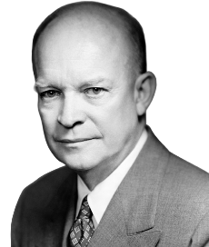
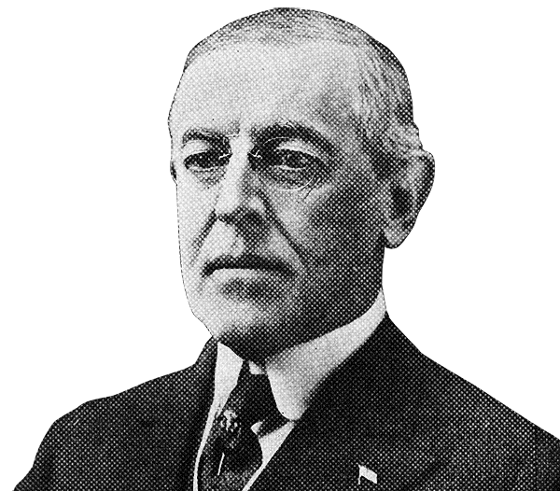
ANSWER # 4
WOODROW WILSON PRINCETON UNIVERSITY
DWIGHT EISENHOWER COLUMBIA UNIVERSITY

Slide 10
QUESTION # 5 IN THE NEWS
EARLIER THIS YEAR, PHILIPS REACHED A $1.1 BILLION DEAL TO SETTLE CLAIMS FROM PEOPLE WHO WERE INJURED BY WHAT MEDICAL DEVICE?

Slide 11
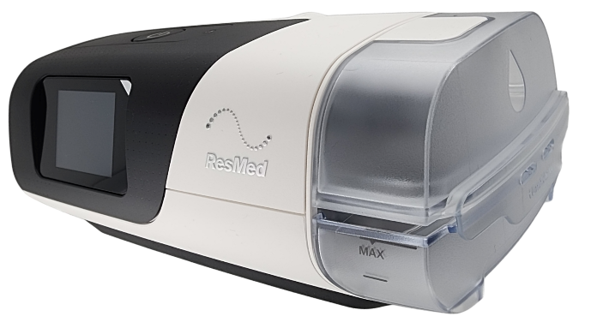
ANSWER # 5
CPAP MACHINE

Slide 12
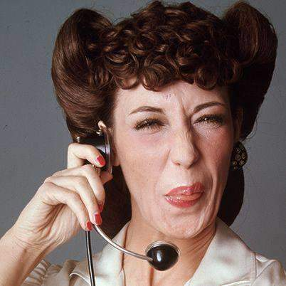
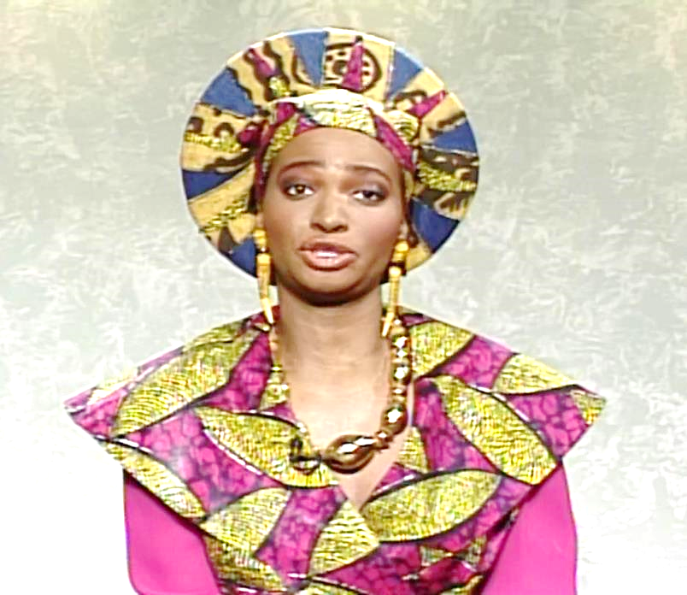
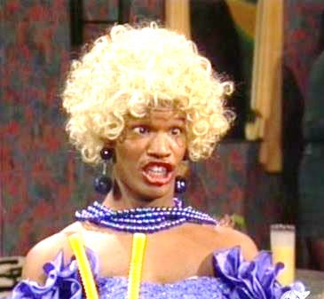
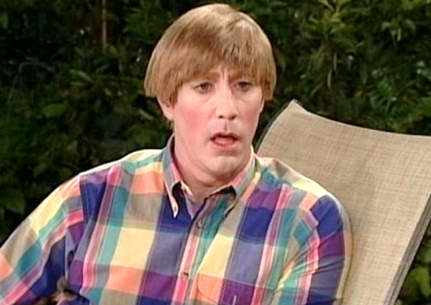
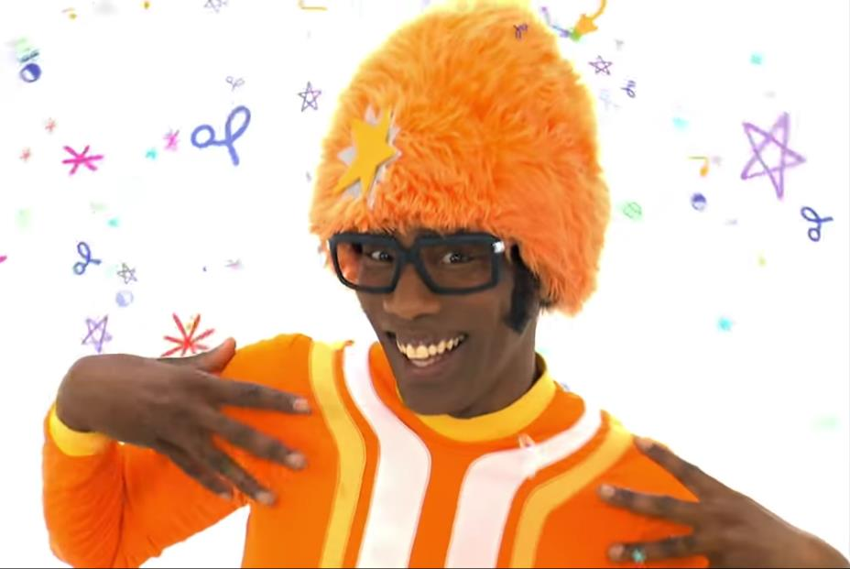
QUESTION # 6
NAME THE TV SKETCH SHOW CHARACTERS

Slide 13
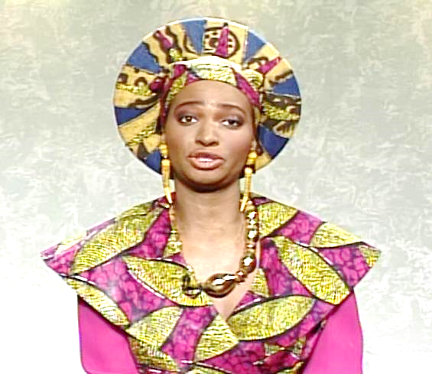
QUEEN SHENEQUA SATURDAY NIGHT LIVE

Slide 14
DJ LANCE ROCK YO GABBA GABBA!

Slide 15
STUART MAD TV

Slide 16
ERNESTINE ROWAN & MARTIN’S LAUGH-IN

Slide 17
WANDA IN LIVING COLOR

Slide 18
QUESTION # 7 NAME THE DECADE
THE U.S. NAVAL ACADEMY IS ESTABLISHED IN ANNAPOLIS
THE MODERN SEWING MACHINE IS INVENTED
ANESTHESIA IS USED FOR THE FIRST TIME DURING AN OPERATION
THE U.S. CONGRESS DECLARES THE FIRST TUESDAY AFTER THE FIRST MONDAY IN NOVEMBER AS ELECTION DAY

Slide 19
ANSWER # 7
1840s

Slide 20
QUESTION # 8 FOOTBALL
4-PARTER
WHICH FOUR CURRENT NFL HEAD COACHES PLAYED IN THE NFL IN THE 1990s?

Slide 21
ANSWER # 8
DAN CAMPBELL
DOUG PEDERSON
JIM HARBAUGH
TODD BOWLES

Slide 22
QUESTION # 9 SCIENCE
THE LARGEST SATELLITE IN THE SOLAR SYSTEM, WHAT LARGEST MOON OF JUPITER WAS DISCOVERED BY GALILEO IN 1610?

Slide 23
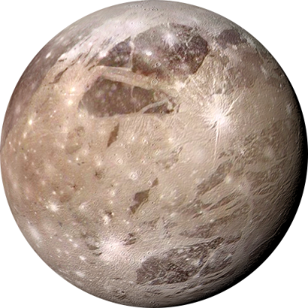
ANSWER # 9
GANYMEDE

Slide 24
QUESTION # 10 MUSIC
3-PARTER
NAME THE THREE SONGS AND THE THEME

Slide 25
ANSWER # 10
SONGS
“IF I COULD TURN BACK TIME” - CHER
“I DON’T WANT TO MISS A THING” - AEROSMITH
“RHYTHM OF THE NIGHT” - DEBARGE
THEME
ALL WRITTEN BY DIANE WARREN

Slide 26
HALFTIME
triviamaryland.com
@triviamaryland

Slide 27
QUESTION # 11 SOCIAL MEDIA
THE FIFTH-MOST RETWEETED TWEET OF ALL TIME WAS POSTED ON AUGUST 28, 2020, ANNOUNCING WHAT CELEBRITY’S DEATH?

Slide 28
ANSWER # 11
CHADWICK BOSEMAN

Slide 29
QUESTION # 12 U.S. STATES 2-PARTER
ALPHABETICALLY, WHAT WERE THE FIRST AND LAST STATES TO JOIN THE UNION IN THE 19TH CENTURY?

Slide 30
ANSWER # 12
ALABAMA
WYOMING

Slide 31
QUESTION # 13 VOCABULARY
THE LATIN WORD FOR CUTTLEFISH, IN PHOTOGRAPHY, WHAT COLOR TONE CONVEYS NOSTALGIA?

Slide 32
ANSWER # 13
SEPIA

Slide 33
QUESTION # 14 BOOKS & AUTHORS 2-PARTER
WHAT TWO SIMILARLY-TITLED BOOKS WRITTEN BY COLLEEN HOOVER REACHED #1 ON THE NEW YORK TIMES BESTSELLER LIST IN 2023?

Slide 34
ANSWER # 14

Slide 35
QUESTION # 15 THEATRE
RECEIVING THIRTEEN NOMINATIONS AT THIS YEAR’S TONY AWARDS, HELL’S KITCHEN IS A MUSICAL BASED ON THE LIFE OF WHAT SINGER?

Slide 36
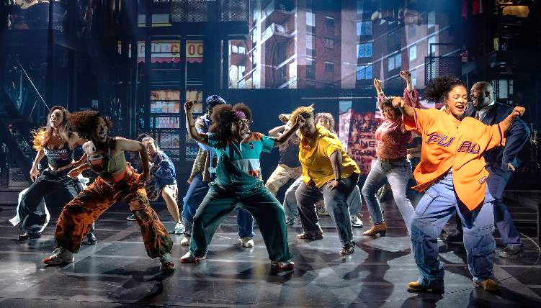
ANSWER # 15
ALICIA KEYS

Slide 37
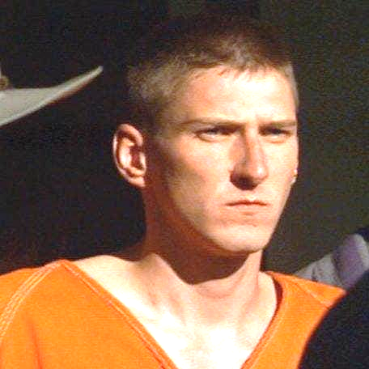
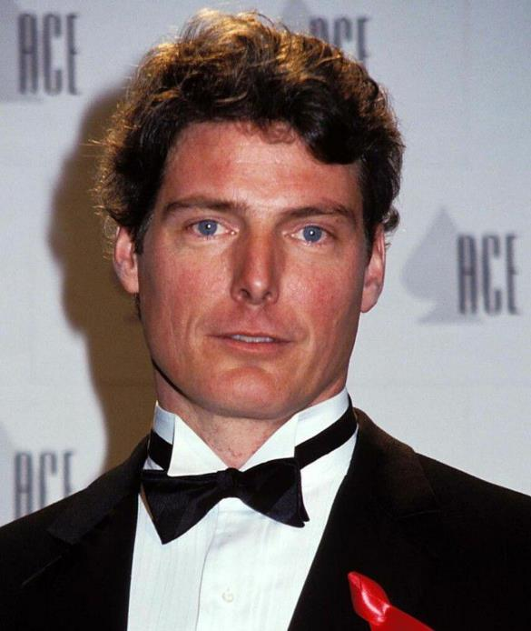
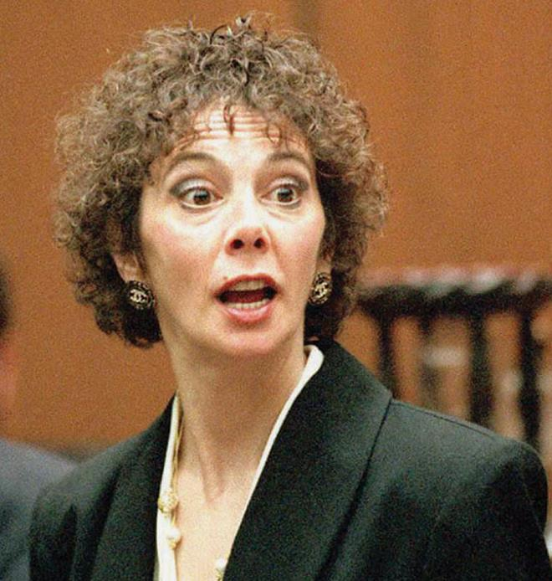
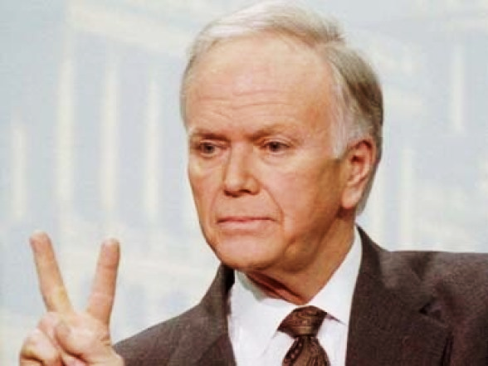
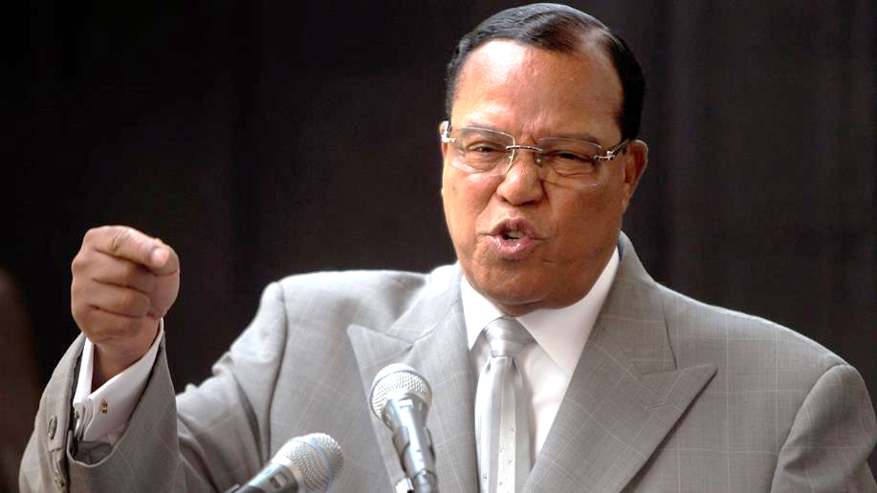
QUESTION # 16
NAME THE 1995 NEWSMAKERS

Slide 38
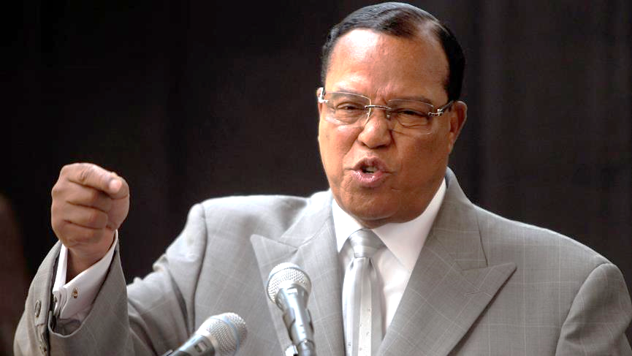
LOUIS FARRAKHAN

Slide 39
MARCIA CLARK

Slide 40
TIMOTHY McVEIGH

Slide 41
CHRISTOPHER REEVE

Slide 42
BOB PACKWOOD

Slide 43
QUESTION # 17 THE HUMAN BODY
THE MOUNT OF APOLLO, THE MOUNT OF THE MOON, AND THE GIRDLE OF VENUS ARE ALL LOCATED ON WHAT PART OF THE BODY?

Slide 44
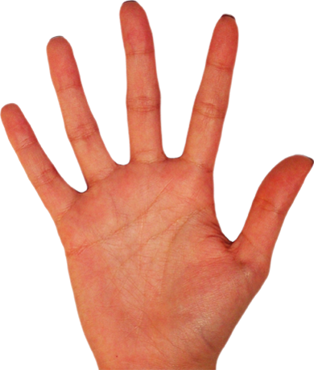
ANSWER # 17
HAND

Slide 45
QUESTION # 18 TOYS & GAMES 3-PARTER
NAME THE TOYS BASED ON THEIR SLOGAN AND THE YEAR THEY WERE ORIGINALLY SOLD IN THE U.S.:
NOW YOU’RE PLAYING WITH POWER - PORTABLE POWER (1989)
FUN TO PLAY WITH, NOT TO EAT (1956)
THE GIRLS WITH A PASSION FOR FASHION (2001)

Slide 46
ANSWER # 18
NOW YOU’RE PLAYING WITH POWER - PORTABLE POWER (1989) - GAMEBOY
FUN TO PLAY WITH, NOT TO EAT (1956) - PLAY DOH
THE GIRLS WITH A PASSION FOR FASHION (2001) - BRATZ

Slide 47
QUESTION # 19
COLLEGES & UNIVERSITIES
FOUNDED IN 1875, THE MISSION OF WHAT UNIVERSITY IS TO ASSIST INDIVIDUALS IN THEIR QUEST FOR PERFECTION AND ETERNAL LIFE?

Slide 48
ANSWER # 19

Slide 49
QUESTION # 20 BET UP TO 15 POINTS MOVIES
WHO WAS THE FIRST ACTOR NOMINATED FOR A BEST ACTOR OSCAR FOR PORTRAYING ANOTHER BEST ACTOR NOMINEE?

Slide 50
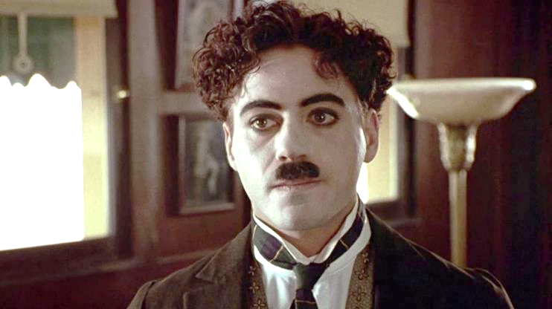
ANSWER # 20
ROBERT DOWNEY, JR. CHAPLIN

Slide 51
TRIVIAMARYLAND
triviamaryland.com @triviamaryland

Slide 52
TIEBREAKER QUESTION
AS OF FALL 2023, HOW MANY UNDERGRADUATE MAJORS ARE OFFERED BY BRIGHAM YOUNG UNIVERSITY?

Slide 53
TIEBREAKER ANSWER
198

