Slide 1
TRIVIAMARYLAND WORLD SERIES
triviamaryland.com
@triviamaryland

Slide 2
RANDY McNALLY
NEPO BABIES
ALL OR NOTHING
MARKSMEN
LINCOLN LOVES ZJs
SWEEP THE LEG
CULT CLASSIC
TRIVIAHOLICS ANONYMOUS
TOO FAST TOO CURIOUS
LITE
MAXIMUM SPARKLE
COUSIN EDDIE’S KIDS
DEATH PUMP
SOD SQUAD
NO IDEA
PIKACHUPACABRAS
ALTERNATIVE FACTS
HAPPY NATIONAL BEER DAY

Slide 3
QUESTION # 1 U.S. HISTORY
RED BLOUNT WAS THE LAST PERSON TO HOLD WHAT TITLE BEFORE IT WAS REMOVED FROM THE U.S. CABINET IN 1971?

Slide 4
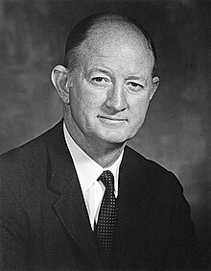
ANSWER # 1
POSTMASTER GENERAL

Slide 5
QUESTION # 2 TOYS & GAMES 3-PARTER
WHAT ARE THE CURRENT NAMES OF BARBIE’S THREE SISTERS?

Slide 6
ANSWER # 2
SKIPPER
STACIE
CHELSEA

Slide 7
QUESTION # 3 BASEBALL
WHO IS THE ONLY CURRENT MLB PLAYER WITH AT LEAST 400 CAREER HOME RUNS?

Slide 8
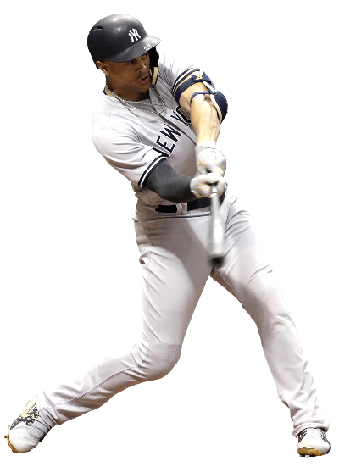
ANSWER # 3
GIANCARLO STANTON

Slide 9
QUESTION # 4 THE HUMAN BODY 2-PARTER
NAMED FOR THE WAY THEY RELEASE SECRETIONS, WHAT ARE THE BODY’S TWO MAIN TYPES OF GLANDS?

Slide 10
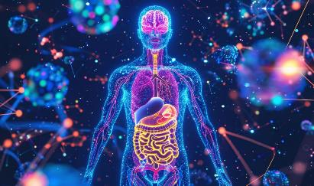
ANSWER # 4
ENDOCRINE
EXOCRINE

Slide 11
QUESTION # 5 WEATHER
WHAT IS THE NAME OF THE TYPHOON THAT SWEPT THROUGH SEVERAL COUNTRIES SURROUNDING THE SOUTH CHINA SEA EARLIER THIS MONTH, CAUSING OVER 400 DEATHS?

Slide 12
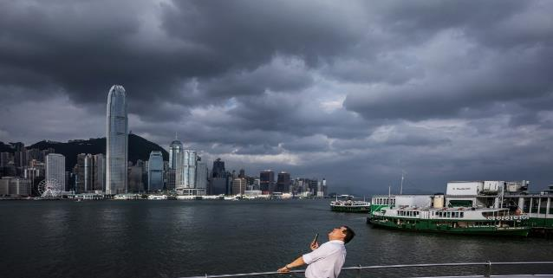
ANSWER # 5
YAGI

Slide 13
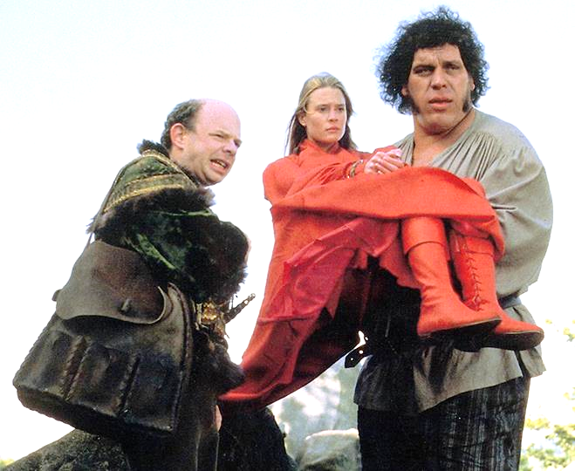
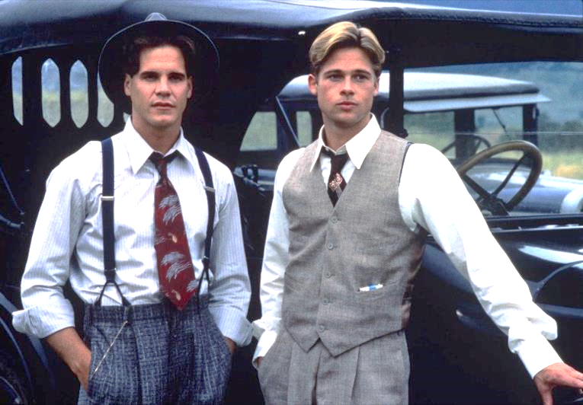
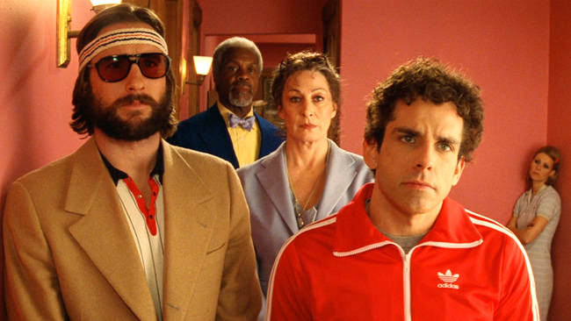
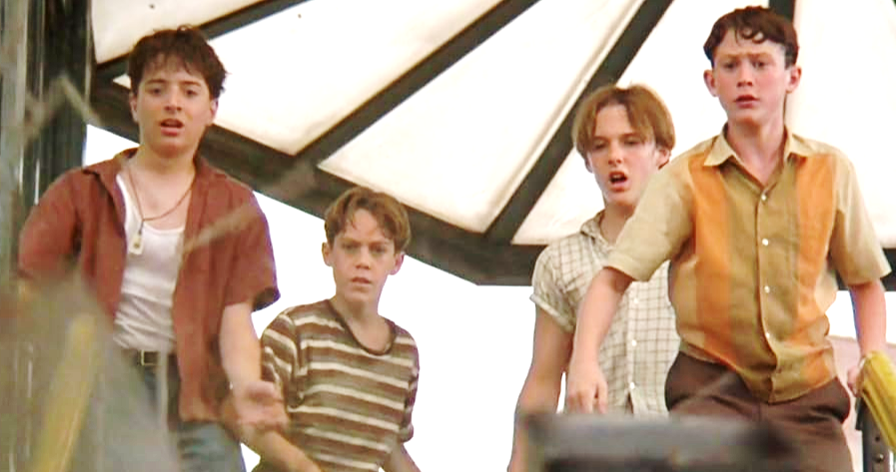
QUESTION # 6
NAME THE NARRATORS

Slide 14
PETER FALK
THE PRINCESS BRIDE

Slide 15
EMMA THOMPSON
STRANGER THAN FICTION

Slide 16
ROBERT REDFORD
A RIVER RUNS THROUGH IT

Slide 17
ALEC BALDWIN
THE ROYAL TENENBAUMS

Slide 18
JASON PATRIC
SLEEPERS

Slide 19
QUESTION # 7 SCIENCE
WATER BOILING AND TURNING INTO STEAM IS AN EXAMPLE OF AN ISOBARIC PROCESS, MEANING WHAT REMAINS CONSTANT?

Slide 20
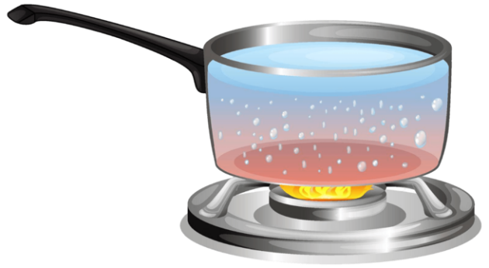
ANSWER # 7
PRESSURE

Slide 21
QUESTION # 8 NEXT IN LINE
3-PARTER
WHAT ARE THE NEXT THREE NAMES ON THIS LIST?
PAULA ABDUL
KARA DIOGUARDI
ELLEN DEGENERES

Slide 22
ANSWER # 8
PERMANENT WOMEN JUDGES ON
JENNIFER LOPEZ
MARIAH CAREY
NICKI MINAJ

Slide 23
QUESTION # 9 ORGANIZATIONS
TO JOIN WHAT GROUP FOUNDED IN 1961, MEMBERS MUST COMMIT TO WORK IN THE HOST COUNTRY FOR TWO YEARS AND LEARN THEIR LANGUAGE?

Slide 24
ANSWER # 9

Slide 25
QUESTION # 10 MUSIC
3-PARTER
NAME THE THREE SONGS AND THE THEME

Slide 26
ANSWER # 10
“THE LIVING YEARS”
“UNWRITTEN”
“UNDER THE BRIDGE”
ALL SONGS FEATURE A CHOIR

Slide 27
HALFTIME
triviamaryland.com
@triviamaryland

Slide 28
QUESTION # 11 BROADCASTING
IN 2020, THE STAFF OF WHAT RADIO PROGRAM AND PODCAST HOSTED BY IRA GLASS BECAME THE FIRST-EVER RECIPIENTS OF A PULITZER PRIZE FOR AUDIO REPORTING?

Slide 29
ANSWER # 11

Slide 30
QUESTION # 12 BUSINESS 3-PARTER
PAYPAL OWNS WHAT OTHER THREE AMERICAN MOBILE PAYMENT COMPANIES?

Slide 31
ANSWER # 12

Slide 32
QUESTION # 13 MARYLAND
ST. CATHARINE, A MUSEUM IN WALDORF, MARYLAND, IS THE HOUSE WHERE JOHN WILKES BOOTH WAS TREATED BY WHAT DOCTOR?

Slide 33
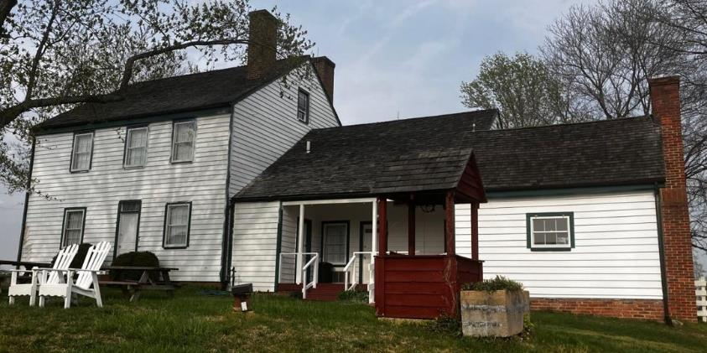
ANSWER # 13
SAMUEL MUDD

Slide 34
QUESTION # 14 6-4-2
THIS IS THE CHESS TERM FOR A SPECIAL TYPE OF TIEBREAKER USED TO DETERMINE THE WINNER OF A MATCH WHEN PREVIOUS GAMES HAVE ENDED IN A DRAW
THIS WORD APPEARS IN SEQUELS TO THE VIDEO GAMES MORTAL KOMBAT, RED FACTION, AND WORMS
A DISASTER MOVIE WITH THIS WORD AS THE TITLE WAS THE HIGHEST-GROSSING FILM WORLDWIDE OF THOSE RELEASED IN 1998

Slide 35
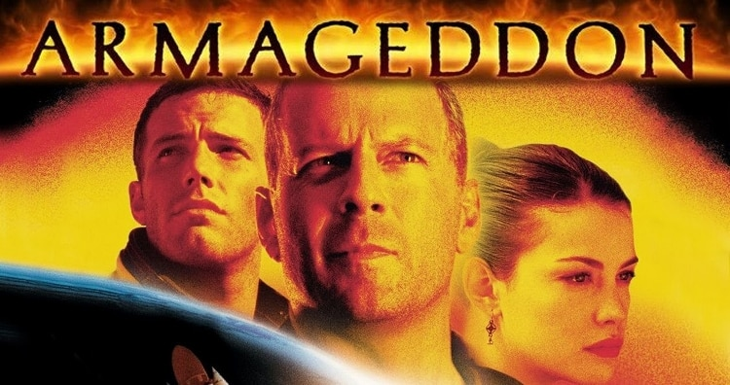
ANSWER # 14

Slide 36
QUESTION # 15 MATHEMATICS
WHAT IS THE TERM FOR A SQUARE OF POSITIVE NUMBERS WHERE THE SUM OF EACH ROW, COLUMN, AND BOTH DIAGONALS ARE THE SAME?

Slide 37
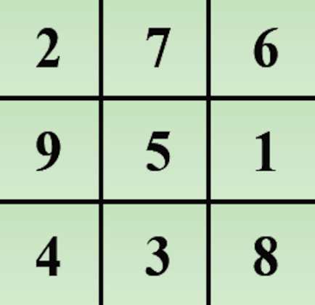
ANSWER # 15
MAGIC SQUARE

Slide 38
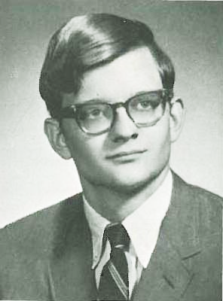
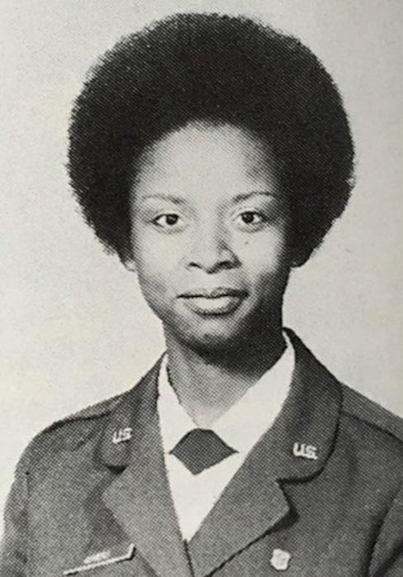
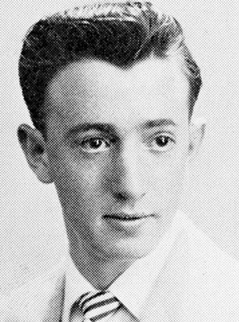
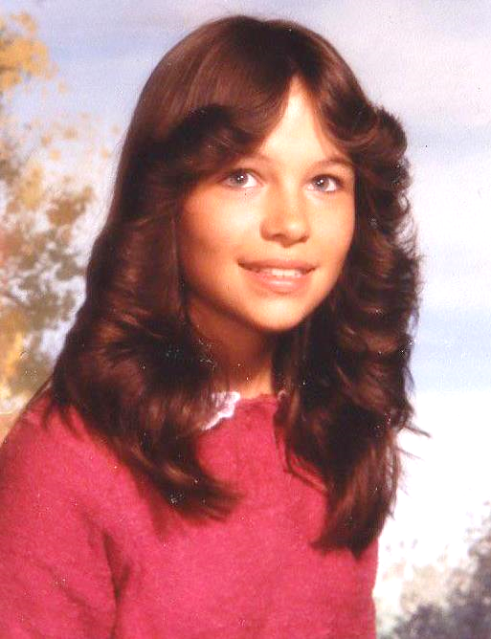
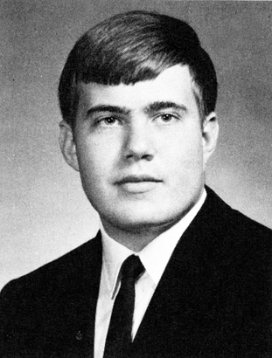
QUESTION # 16
WHO ARE WE?

Slide 39
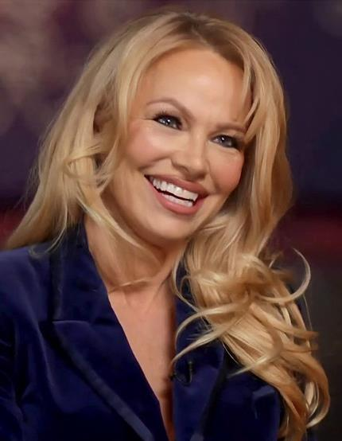
PAMELA ANDERSON

Slide 40
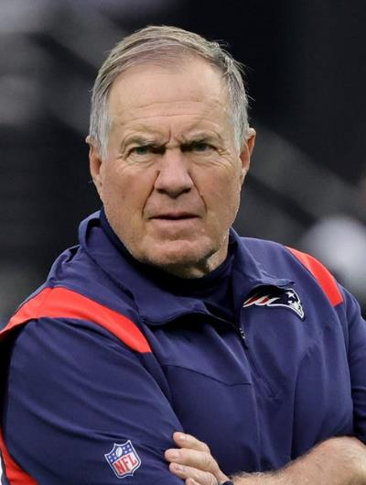
BILL BELICHICK

Slide 41
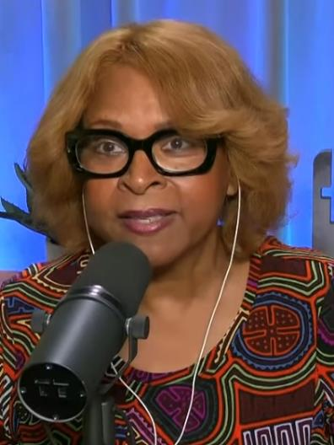
ROBIN QUIVERS

Slide 42
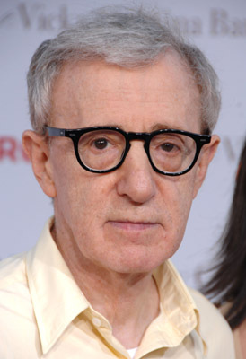
WOODY ALLEN

Slide 43
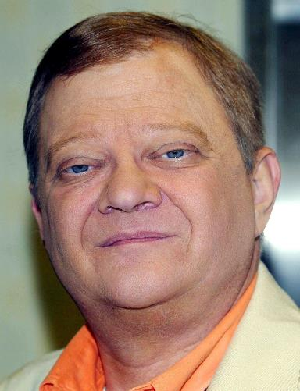
TOM CLANCY

Slide 44
QUESTION # 17 WORLD GEOGRAPHY
WHAT LETTER BEGINS THE NAMES OF THREE DIFFERENT AFRICAN COUNTRIES THAT ALL BORDER ONE ANOTHER?

Slide 45
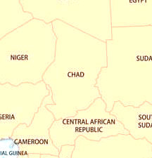
ANSWER # 17
C CHAD, CAMEROON, CENTRAL AFRICAN REPUBLIC

Slide 46
QUESTION # 18 LITERATURE 3-PARTER
WHAT THREE COLLECTIONS OF POETRY BY SHEL SILVERSTEIN WERE PUBLISHED DURING HIS LIFETIME?

Slide 47
ANSWER # 18
WHERE THE SIDEWALK ENDS
A LIGHT IN THE ATTIC
FALLING UP

Slide 48
QUESTION # 19
DEFINITIONS
WHAT WORD CAN MEAN AN ORIGINAL MODEL OF SOMETHING OR, IN PSYCHOLOGY, ANY UNCONSCIOUS IDEA HELD BY ALL MEMBERS OF SOCIETY?

Slide 49
ANSWER # 19
ARCHETYPE

Slide 50
QUESTION # 20 BET UP TO 15 POINTS MUSIC
OF CITIES WITH A POPULATION OF AT LEAST 10,000, WHAT IS THE ONLY U.S. CITY THAT APPEARED IN THE TITLE OF A U.S. BILLBOARD #1 HIT IN THE 1980s?

Slide 51
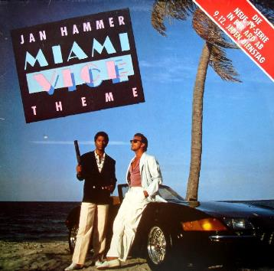
ANSWER # 20
MIAMI (KOMONO ACCEPTABLE TOO)

Slide 52
TRIVIAMARYLAND
triviamaryland.com @triviamaryland

Slide 53
TIEBREAKER QUESTION
HOW MANY QUESTIONS WERE INCLUDED WITH THE ORIGINAL TRIVIAL PURSUIT BOARD GAME?

Slide 54
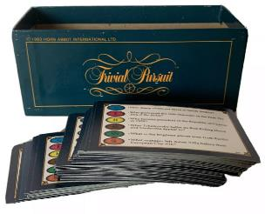
TIEBREAKER ANSWER
6,000

