Slide 1
TRIVIAMARYLAND WORLD SERIES
TRIVIAMARYLAND.COM
FACEBOOK.COM/TRIVIAMARYLAND

Slide 2
SAVE THE DATE!
OUR 6TH ANNUAL OCEAN CITY TRIVIA TOURNAMENT
MAY 4, 2019 AT SANIBEL’S IN OCEAN CITY, MD
EMAIL KENT@TRIVIAMARYLAND.COM FOR DETAILS

Slide 3
CENTRAL PLAYOFF TEAMS
Fear the crab
Joppatowne Christian church fighting communion wafers
Master debators
The best of the wurst
Knights of knee
clueless
Fresh pricks of bel air
Pub crawl liecthenstein
Marksmen
Hopppy bunch
Fat kids
Donner party
infinity
Run over by a puffin
The undecided
Dingo ate my baby
Fab four
I’m so hungry
Casks
Whiskey tango foxtrot
Let the wookie win
I saw the devil
Notes:
North, Central, West, South

Slide 4
QUESTION # 1 BUSINESS
PLACING OVER 700,000 EMPLOYEES EVERY YEAR, WHAT FORTUNE 500 COMPANY LAUNCHED THE TEMPORARY STAFFING INDUSTRY IN 1946?

Slide 5
ANSWER # 1

Slide 6
QUESTION # 2 GOVERNMENT 4-PARTER
WHAT WERE THE FOUR ORIGINAL CABINET POSITIONS DURING GEORGE WASHINGTON’S PRESIDENCY?

Slide 7
ANSWER # 2
SECRETARY OF STATE
SECRETARY OF THE TREASURY
SECRETARY OF WAR
ATTORNEY GENERAL

Slide 8
QUESTION # 3 TENNIS
WHO WAS THE LAST AMERICAN MAN TO WIN THE U.S. OPEN, WHICH WAS THIS ATHLETE’S ONLY CAREER GRAND SLAM VICTORY?

Slide 9
ANSWER # 3
ANDY RODDICK

Slide 10
QUESTION # 4 TELEVISION 4-PARTER
WHAT FOUR WOMEN HAVE CO-HOSTED THE VIEW FOR AT LEAST 10 SEASONS?

Slide 11
ANSWER # 4
JOY BEHAR
BARBARA WALTERS
WHOOPI GOLDBERG
ELISABETH HASSELBECK

Slide 12
QUESTION # 5 AWARDS
16-YEAR-OLD GRETA THUNBERG WAS NOMINATED FOR A 2019 NOBEL PEACE PRIZE FOR HER EFFORTS TO RAISE AWARENESS OF WHAT ISSUE?

Slide 13
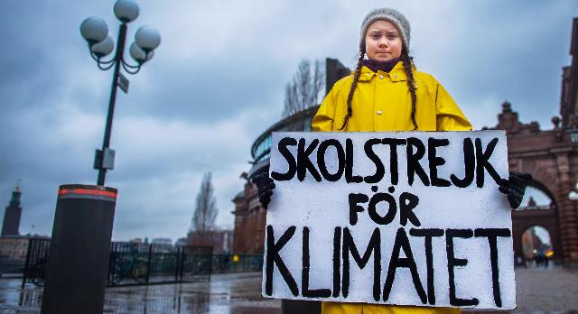
ANSWER # 5
CLIMATE CHANGE

Slide 14
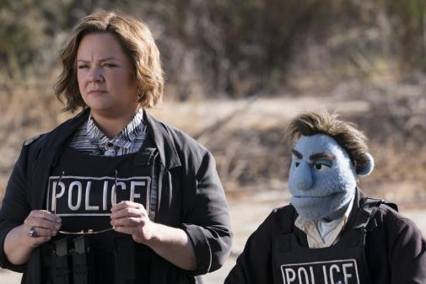
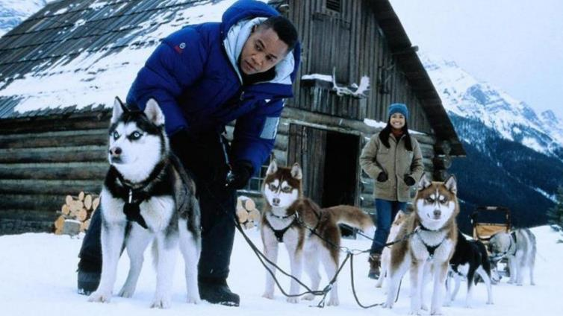
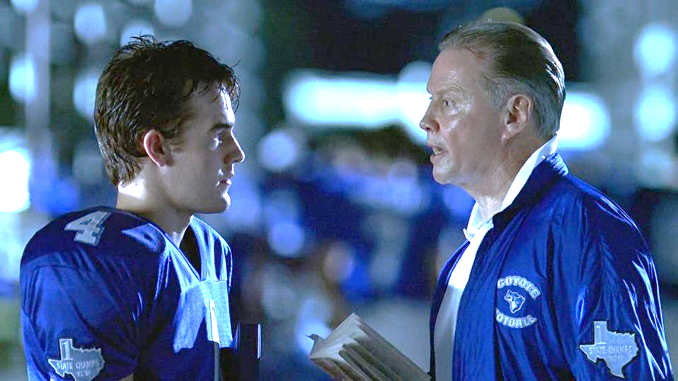
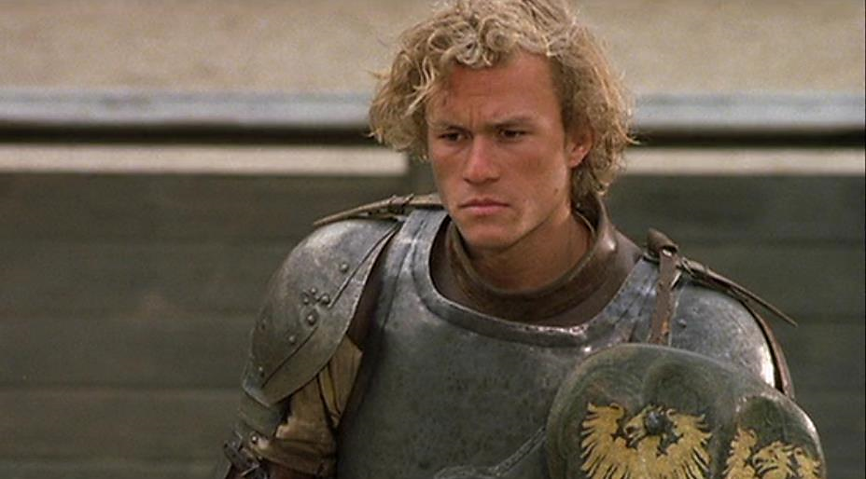
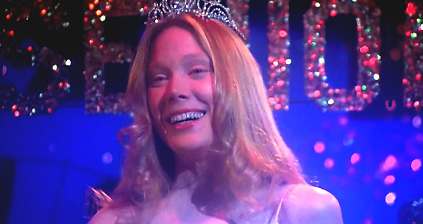
QUESTION # 6
NAME THE MOVIES AND THE THEME

Slide 15
THEME
ALL DIRECTED BY MEN NAMED BRIAN

Slide 16
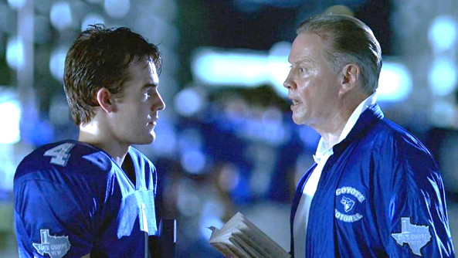
ANSWER #6
VARSITY BLUES BRIAN ROBBINS

Slide 17
CARRIE BRIAN DE PALMA

Slide 18
THE HAPPYTIME MURDERS BRIAN HENSON

Slide 19
A KNIGHT’S TALE BRIAN HELGELAND

Slide 20
SNOW DOGS BRIAN LEVANT

Slide 21
QUESTION # 7 WORLD HISTORY
“OPERATION DYNAMO” WAS THE CODENAME GIVEN TO THE EVACUATION OF WHAT TOWN IN NORTHERN FRANCE DURING WORLD WAR II?

Slide 22
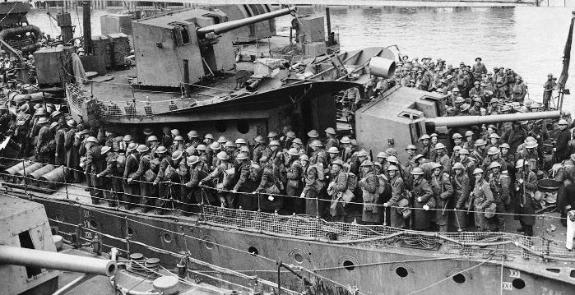
ANSWER # 7
DUNKIRK

Slide 23
QUESTION # 8 VIDEO GAMES 3-PARTER
WHAT WERE THE FIRST THREE SEQUELS TO THE LEGEND OF ZELDA, ALL OF WHICH FEATURED THE MAIN PROTAGONIST’S NAME IN THE TITLES?

Slide 24
ANSWER # 8
THE ADVENTURE OF LINK
A LINK TO THE PAST
LINK’S AWAKENING

Slide 25
QUESTION # 9 ANIMALS
WITH OVER 1,500 SPECIES AND POPULATIONS ON ALL CONTINENTS EXCEPT ANTARCTICA, WHAT TYPE OF ANIMAL IS A SKINK?

Slide 26
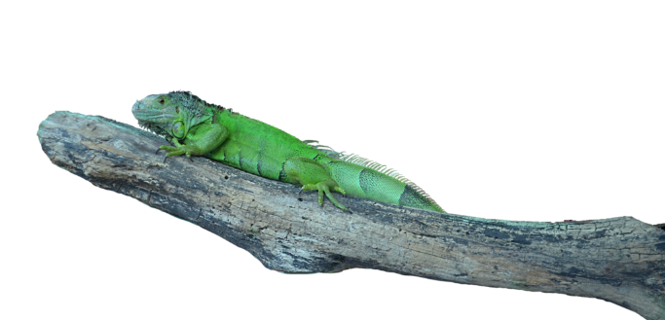
ANSWER # 9
LIZARD

Slide 27
QUESTION # 10 MUSIC
4-PARTER
NAME THE SONG AND THE THREE ARTISTS/GROUPS PERFORMING IT

Slide 28
ANSWER # 10
SONG
“HAPPY TOGETHER”
ARTISTS/GROUPS
WEEZER
MILEY CYRUS
DONNY OSMOND

Slide 29
HALFTIME
TRIVIAMARYLAND.COM
FACEBOOK.COM/TRIVIAMARYLAND

Slide 30
QUESTION # 11 WEIGHTS & MEASUREMENTS
WHAT UNIT OF MEASUREMENT WAS ORIGINALLY DESIGNED TO EQUAL ONE FORTY-MILLIONTH OF THE EARTH’S CIRCUMFERENCE?

Slide 31
ANSWER # 11
METER

Slide 32
QUESTION # 12 TV & CHEMISTRY 2-PARTER
WHAT TWO ELEMENTS ON THE PERIODIC TABLE APPEAR IN THE LOGO FOR THE TV SHOW BREAKING BAD?

Slide 33
ANSWER # 12
BROMINE
BARIUM

Slide 34
QUESTION # 13 FOOD & DRINK
IN 2004, PEPSICO INTRODUCED WHAT VERSION OF PEPSI WITH HALF THE SUGAR, CARBS, AND CALORIES?

Slide 35
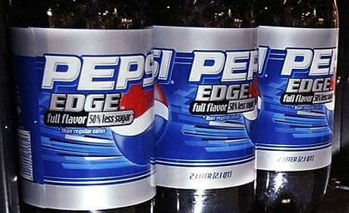
ANSWER # 13

Slide 36
QUESTION # 14 BASEBALL 3-PARTER
WHAT THREE TEAMS THAT WERE MEMBERS OF THE AMERICAN LEAGUE EAST IN THE 1980s ARE NO LONGER A PART OF THE DIVISION?

Slide 37
ANSWER # 14

Slide 38
QUESTION # 15 PHILOSOPHY
THE 17TH CENTURY PROPOSITION KNOWN AS PASCAL’S WAGER ARGUES THAT RATIONAL PEOPLE SHOULD DO WHAT?

Slide 39
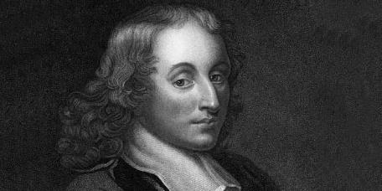
ANSWER # 15
BELIEVE THAT GOD EXISTS

Slide 40
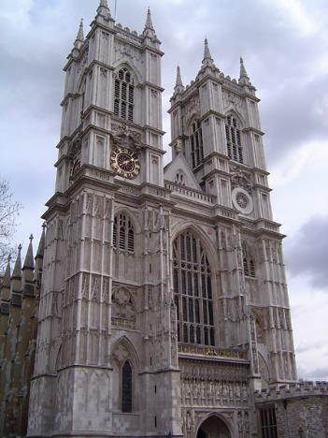
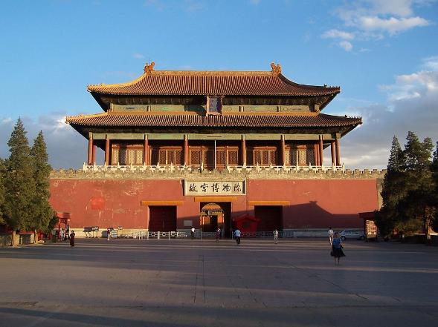
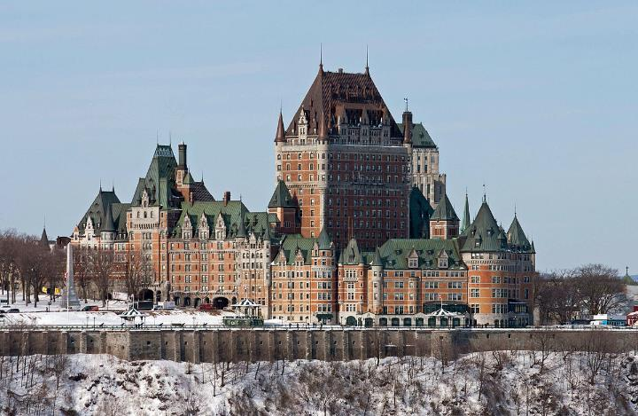
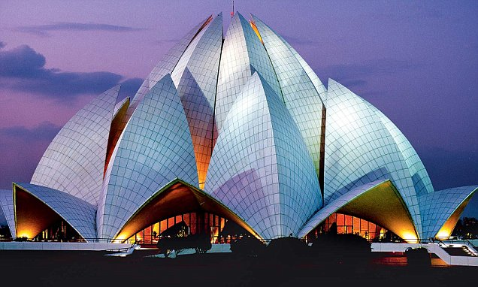
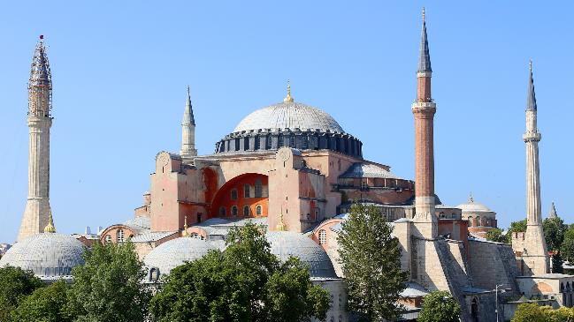
QUESTION # 16
NAME THE LANDMARKS

Slide 41
ANSWER #16
HAGIA SOPHIA TURKEY

Slide 42
WESTMINSTER ABBEY UNITED KINGDOM

Slide 43
CHÂTEAU FRONTENAC CANADA

Slide 44
LOTUS TEMPLE INDIA

Slide 45
FORBIDDEN CITY CHINA

Slide 46
QUESTION # 17 MOVIES
WHAT 2016 MOVIE WAS THE FIRST OSCAR NOMINEE FOR BEST PICTURE RELEASED BY AN INTERNET STREAMING SERVICE?

Slide 47
ANSWER # 17

Slide 48
QUESTION # 18 HISTORIC DOCUMENTS 3-PARTER
WHAT THREE THINGS DO WE “MUTUALLY PLEDGE TO EACH OTHER” IN THE FINAL SENTENCE OF THE DECLARATION OF INDEPENDENCE?

Slide 49
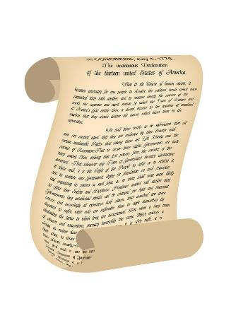
ANSWER # 18
LIVES
FORTUNES
SACRED HONOR

Slide 50
QUESTION # 19 ABBREVIATIONS
WHAT ABBREVIATION’S MEANING AS AN INDIVIDUAL PRODUCT DATES TO 1977, WHILE ITS MEANING AS CONFORMING TO ORTHODOX OPINION DATES TO 1986?

Slide 51
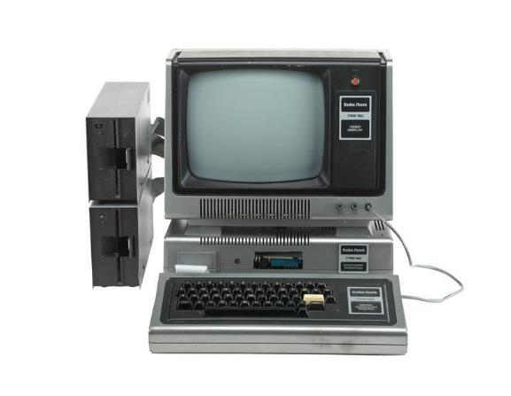
ANSWER # 19
PC

Slide 52
QUESTION # 20 BET UP TO 15 POINTS #1 HITS
WHAT ARTIST HAD THE FIRST POSTHUMOUS #1 SONG ON THE U.S. BILLBOARD HOT 100 CHART?

Slide 53
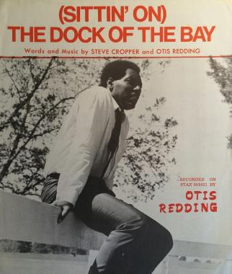
ANSWER # 20
OTIS REDDING

Slide 54
TRIVIAMARYLAND
TRIVIAMARYLAND.COM
FACEBOOK.COM/TRIVIAMARYLAND

Slide 55
TIEBREAKER
AS OF YESTERDAY, BARACK OBAMA HAD THE SECOND-MOST TWITTER FOLLOWERS WITH HOW MANY?

Slide 56
TIEBREAKER ANSWER
105,407,390

