Slide 1
TRIVIAMARYLAND WORLD SERIES
triviamaryland.com
@triviamaryland

Slide 2
QUESTION # 1 MARYLAND
FOUNDED BY THE WRIGHT BROTHERS IN 1909, WHAT MARYLAND CITY IS HOME TO THE OLDEST CONTINUOUSLY OPERATING AIRPORT?

Slide 3
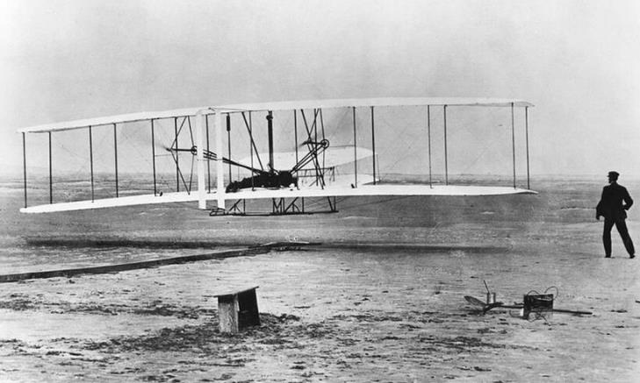
ANSWER # 1
COLLEGE PARK

Slide 4
QUESTION # 2 MOVIES 2-PARTER
FOR MOVIES RELEASED IN THE 1990s, WHAT TWO DIRECTORS WON THE BEST DIRECTOR OSCAR FOR THEIR FEATURE FILM DEBUTS?

Slide 5
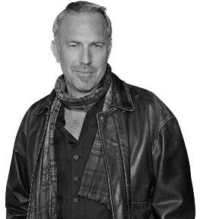
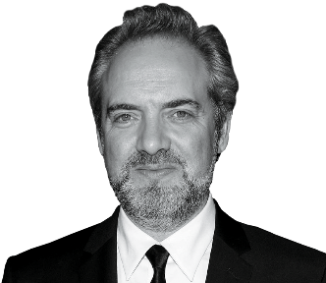
ANSWER # 2
KEVIN COSTNER
SAM MENDES

Slide 6
QUESTION # 3 THEATRE
IN SPAIN, WHAT MUSICAL IS KNOWN AS BRILLANTINE, WHILE IN MEXICO IT’S CALLED VASELINA?

Slide 7
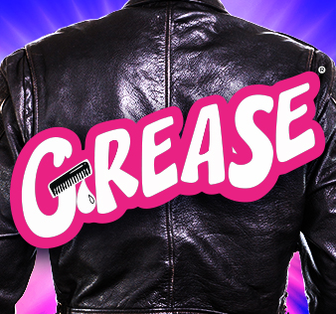
ANSWER # 3

Slide 8
QUESTION # 4 POLITICIANS 2-PARTER
WHAT TWO CANDIDATES HAVE REPRESENTED THE GREEN PARTY IN AT LEAST TWO U.S. PRESIDENTIAL ELECTIONS?

Slide 9
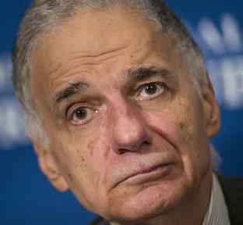
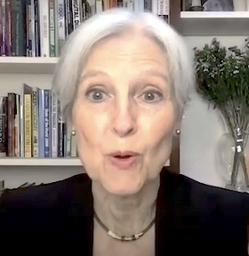
ANSWER # 4
RALPH NADER
JILL STEIN

Slide 10
QUESTION # 5 IN THE NEWS
EARLIER THIS MONTH, OVER 2,000 OF WHAT TYPE OF WORKERS WERE FIRED IN NEW YORK FOR FAILING TO RETURN TO WORK AFTER A 22-DAY STRIKE?

Slide 11
ANSWER # 5
PRISON GUARDS

Slide 12
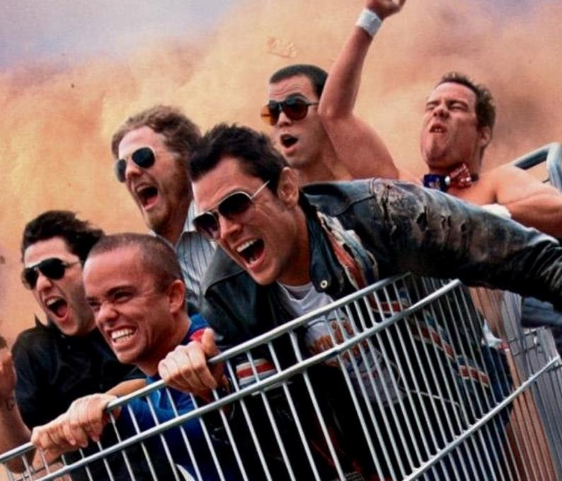
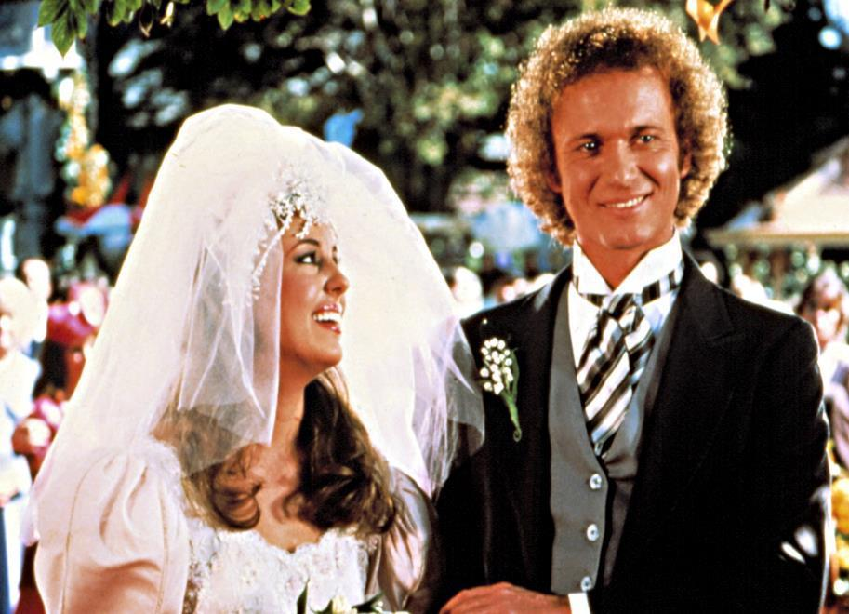
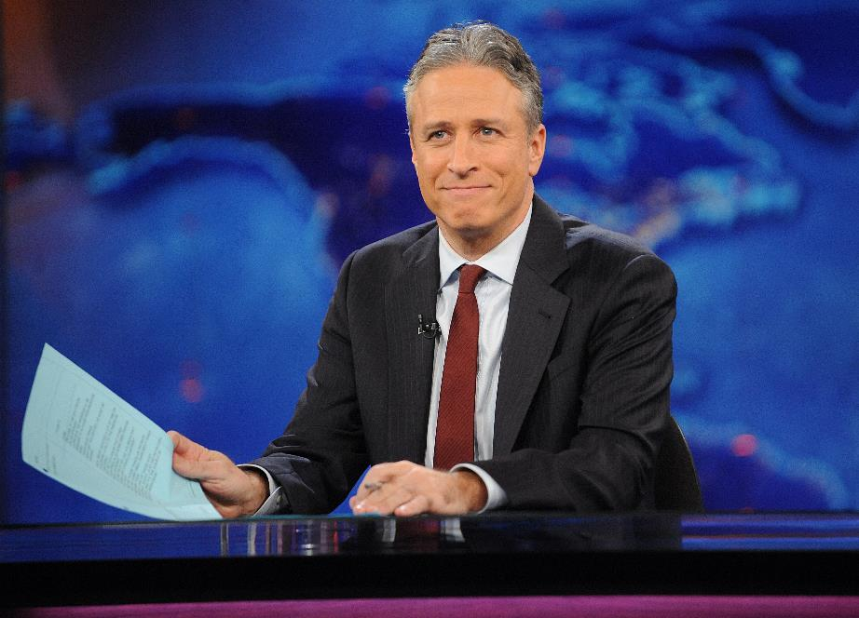
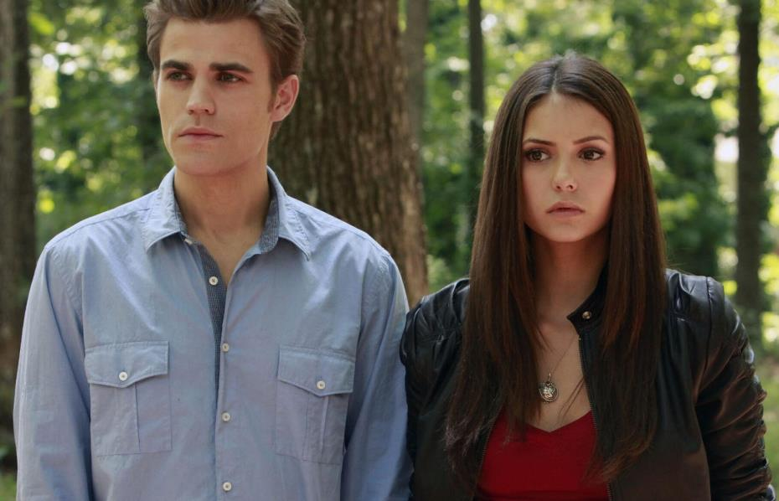
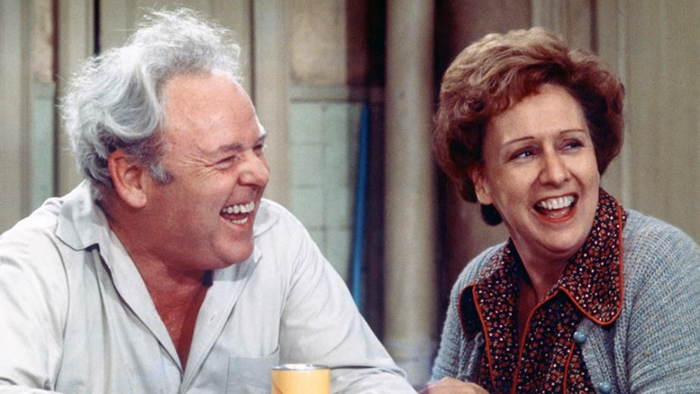
QUESTION # 6
NAME THEIR FIRST SPIN-OFFS

Slide 13
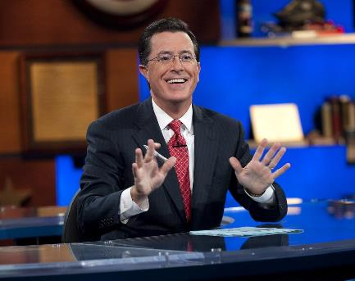
THE COLBERT REPORT THE DAILY SHOW

Slide 14
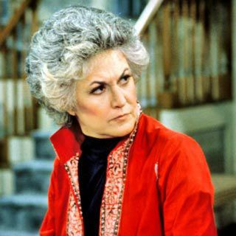
MAUDE ALL IN THE FAMILY

Slide 15
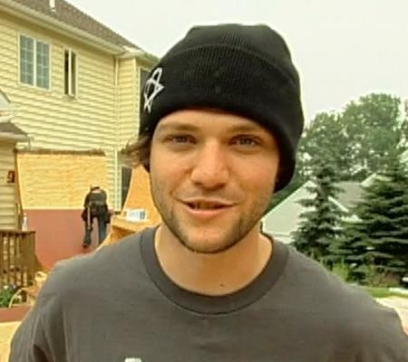
VIVA LA BAM JACKASS

Slide 16
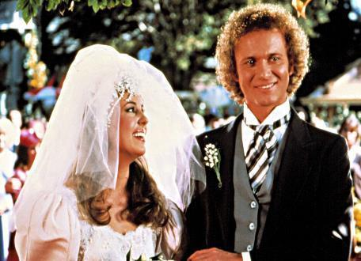
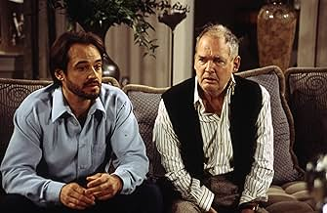
PORT CHARLES GENERAL HOSPITAL

Slide 17
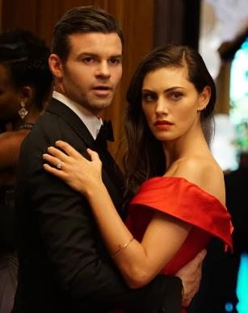
THE ORIGINALS THE VAMPIRE DIARIES

Slide 18
QUESTION # 7 ASTRONOMY
WHAT IS THE ONLY DWARF PLANET LOCATED IN THE INNER SOLAR SYSTEM, ORBITING THE SUN BETWEEN MARS AND JUPITER?

Slide 19
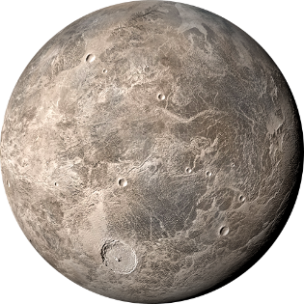
ANSWER # 7
CERES

Slide 20
QUESTION # 8 LITERATURE
2-PARTER
BOTH PART OF THE EMPYREAN SERIES, WHAT TWO NOVELS BY REBECCA YARROS HAVE REACHED #1 ON THE NEW YORK TIMES BESTSELLER LIST IN 2025?

Slide 21
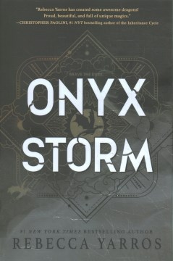
ANSWER # 8

Slide 22
QUESTION # 9 THIS DATE IN HISTORY
ON MARCH 29, 1882, WHAT CATHOLIC FRATERNAL ORGANIZATION WAS FOUNDED BY FATHER MICHAEL McGIVNEY IN CONNECTICUT?

Slide 23
ANSWER # 9

Slide 24
QUESTION # 10 MUSIC
3-PARTER
NAME THE SIBLINGS (by last name)

Slide 25
ANSWER # 10
KNIGHT NEW KIDS ON THE BLOCK
DAVIES THE KINKS
FOLLOWILL KINGS OF LEON

Slide 26
HALFTIME
triviamaryland.com
@triviamaryland

Slide 27
QUESTION # 11 FOOTBALL
WHAT IS THE ONLY NFL TEAM THAT HAS PLAYED IN BOTH THE AFC AND NFC CHAMPIONSHIP GAMES?

Slide 28
ANSWER # 11

Slide 29
QUESTION # 12 BODIES OF WATER 2-PARTER
WHILE THE WHITE BAND ON NICARAGUA’S FLAG REPRESENTS THE LAND, THE BLUE BANDS REPRESENT WHAT TWO BODIES OF WATER IT BORDERS?

Slide 30
ANSWER # 12
PACIFIC OCEAN
CARIBBEAN SEA

Slide 31
QUESTION # 13 BUSINESS
AS TIRES WEREN’T COLORED BLACK UNTIL THE 1910s, BIBENDUM, THE MASCOT OF WHAT COMPANY FOUNDED IN 1889, IS WHITE?

Slide 32
ANSWER # 13
MICHELIN

Slide 33
QUESTION # 14 VIDEO GAMES 4-PARTER
FOLLOWING THE RELEASE OF ARENA IN 1994, WHAT ARE THE TITLES OF THE FOUR MAIN SEQUELS TO THE VIDEO GAME ELDER SCROLLS?

Slide 34
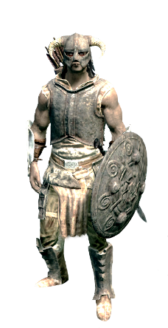
ANSWER # 14
DAGGERFALL
MORROWIND
OBLIVION
SKYRIM

Slide 35
QUESTION # 15 ROYALTY
WHO IS CURRENTLY SECOND IN THE LINE OF SUCCESSION TO THE BRITISH THRONE?

Slide 36
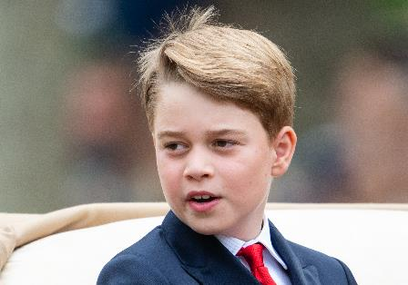
ANSWER # 15
PRINCE GEORGE OF WALES

Slide 37
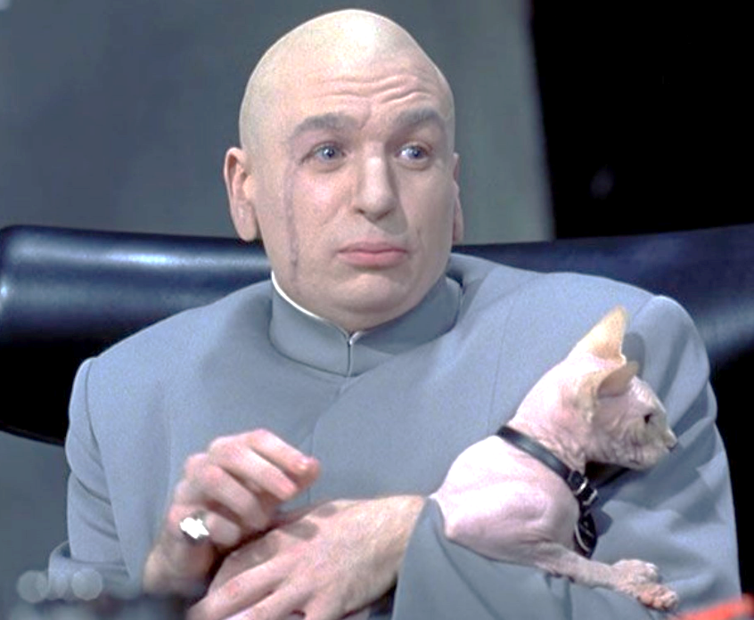
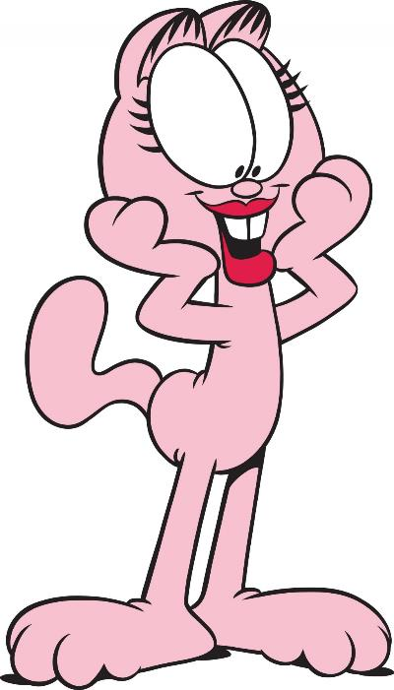
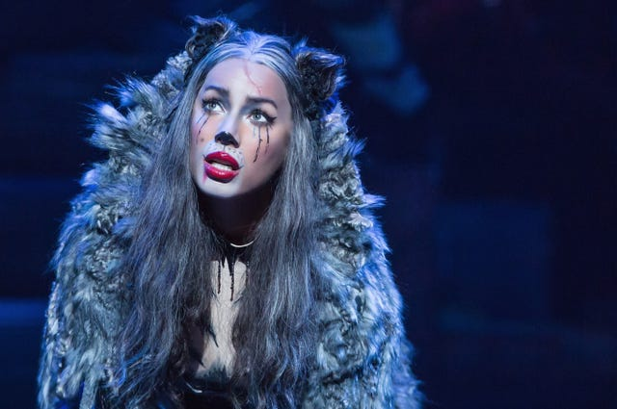
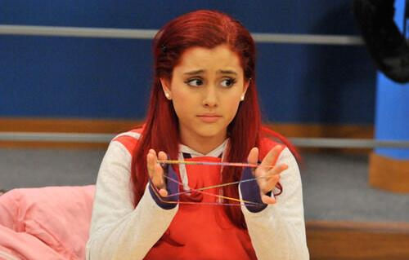
QUESTION # 16
NAME THE FICTIONAL CATS

Slide 38
MR. BIGGLESWORTH AUSTIN POWERS

Slide 39
MC SKAT KAT “OPPOSITES ATTRACT” VIDEO - PAULA ABDUL

Slide 40
GRIZABELLA CATS

Slide 41
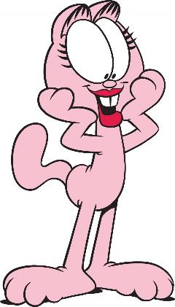
ARLENE GARFIELD COMICS

Slide 42
CAT VALENTINE VICTORIOUS/SAM & CAT

Slide 43
QUESTION # 17 FOREIGN WORDS & PHRASES
TO GRADUATE ‘CUM LAUDE’ LITERALLY MEANS TO GRADUATE ‘WITH’ WHAT?

Slide 44
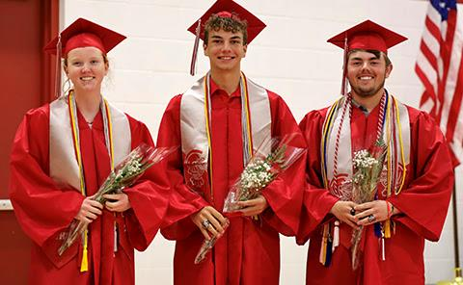
ANSWER # 17
PRAISE

Slide 45
QUESTION # 18 THE HUMAN BODY 4-PARTER
WHAT ARE THE NAMES OF THE FOUR VALVES LOCATED IN THE HEARTS OF ALL MAMMALS?

Slide 46
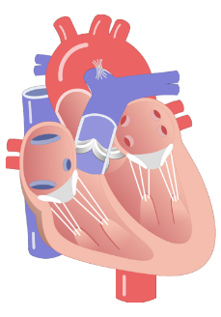
ANSWER # 18
PULMONARY
TRICUSPID
MITRAL
AORTIC

Slide 47
QUESTION # 19
COMEDY
WHAT COMEDIAN HAS A CHANNEL ON SIRIUS XM CALLED “LAUGH OUT LOUD” AND A PODCAST CALLED “GOLD MINDS”?

Slide 48
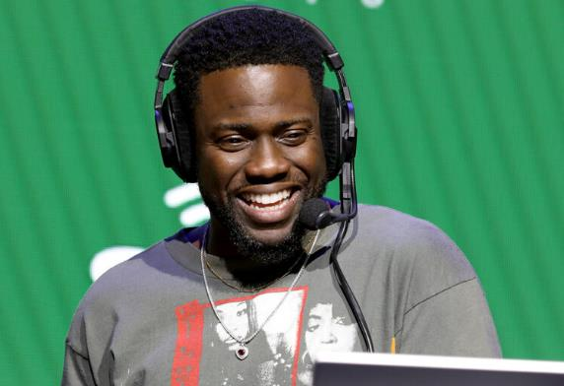
ANSWER # 19
KEVIN HART

Slide 49
QUESTION # 20 BET UP TO 15 POINTS AWARDS
WHAT IS THE LAST NAME OF ALFRED, LIONEL, RANDY, DAVID, EMIL, AND THOMAS, WHO WITH 95 NOMINATIONS, ARE THE MOST OSCAR-NOMINATED FAMILY IN HISTORY?

Slide 50
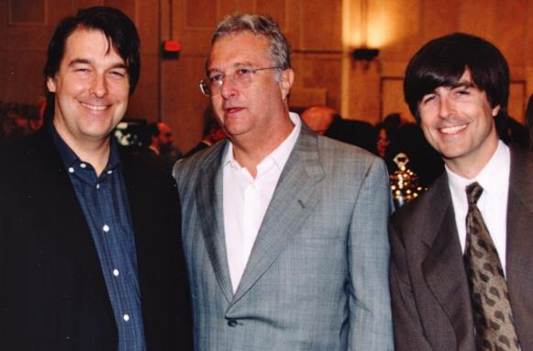
ANSWER # 20
NEWMAN

Slide 51
TRIVIAMARYLAND
triviamaryland.com @triviamaryland

Slide 52
TIEBREAKER QUESTION
THE MOST IN THE COUNTRY, HOW MANY DIFFERENT LICENSE PLATE DESIGNS DOES MARYLAND OFFER?

Slide 53
TIEBREAKER ANSWER
989

