Slide 1
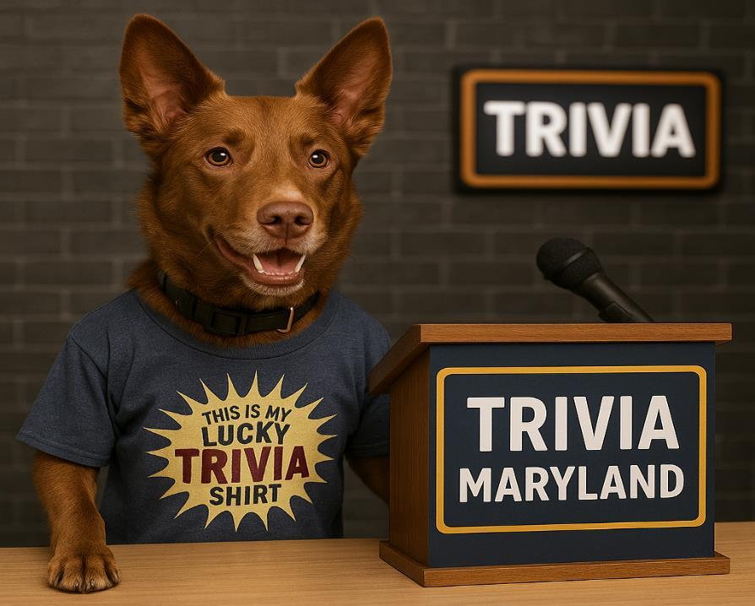
WELCOME TO THE
WORLD SERIES
WINTER 2025

Slide 2
HERE ARE YOUR WINTER 2025 WORLD SERIES TEAMS
• LINCOLN LOVES ZJS
• NEW WU ORDER
• DOH
• SLAM DUNK
• B SQUAD
• SHANEALICIOUS
• MASTER DEBATORS
• QUIZ MY PANTS
• GARY’S BUTTERCUPS
• WINNERS OF EUROVISION
• NORFOLK & WAY
• SQUANDERERS
• GO BIG OR GO HOME
• MARKSMEN
• LITE
• THINKIN’ AND DRINKIN’
• GOING BATTY
• CUPID STUNTS
• NO IDEA
• BLACK FLAMINGOS

Slide 3
QUESTION # 1 AMENITIES
“NO NEED TO BREAK IN” WAS WRITTEN ON THE KEY CARDS OF WHICH HOTEL THAT REOPENED IN 2016?

Slide 4
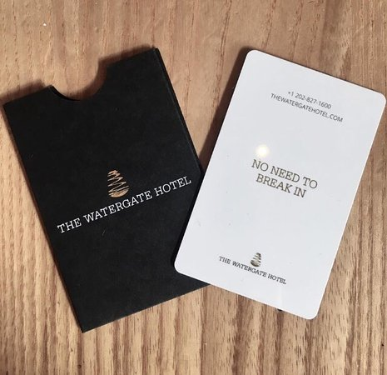
ANSWER # 1
THE WATERGATE HOTEL

Slide 5
QUESTION # 2 “AWARDS” 2 - PART
THE MOST EVER, WHICH TWO MEN HAVE BEEN NOMINATED FOR ELEVEN PRIMETIME EMMY AWARDS FOR OUTSTANDING CHARACTER VOICE-OVER PERFORMANCES?

Slide 6
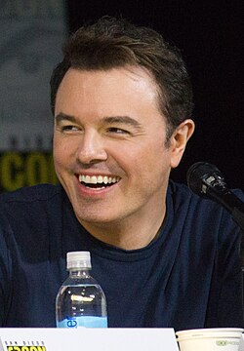
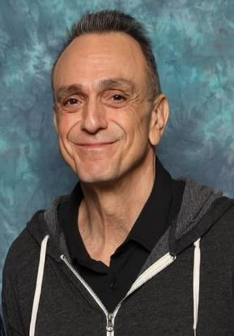
ANSWER # 2
SETH MacFARLANE
HANK AZARIA

Slide 7
TIE BREAKER QUESTION
HOW MANY WORDS WAS FRANKLIN D. ROOSEVELT’S “DAY OF INFAMY” SPEECH THAT WAS DELIVERED TO CONGRESS ON DECEMBER 8, 1941?

Slide 8
QUESTION # 3 FOOD AND DRINK
IN LOCATIONS AROUND BALTIMORE AND SAN ANTONIO LAST DECEMBER AND JANUARY, SELECT CHICK-FIL-A STORES TESTED WHICH TYPE OF SANDWICH - A PENNSYLVANIA DUTCH TREAT?

Slide 9
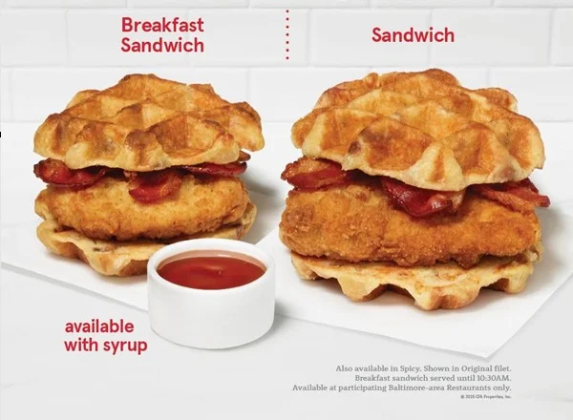
ANSWER # 3
CHICKEN AND WAFFLES

Slide 10
QUESTION # 4 MUSIC 4 - PART
RELEASED IN 1962, 1963 (x2), AND 1971, WHICH FOUR STUDIO ALBUMS BY THE BEACH BOYS HAVE A VARIATION OF THE WORD “SURF” IN THEIR TITLE?

Slide 11
ANSWER # 4
• SURFIN’ SAFARI
• SURFIN’ U.S.A.
• SURFER GIRL
• SURF’S UP

Slide 12
QUESTION # 5 THE NATIONAL FOOTBALL LEAGUE
“JUST WIN, BABY” WAS THE MOTTO OF WHICH NFL OWNER WHO PASSED AWAY IN 2011?

Slide 13
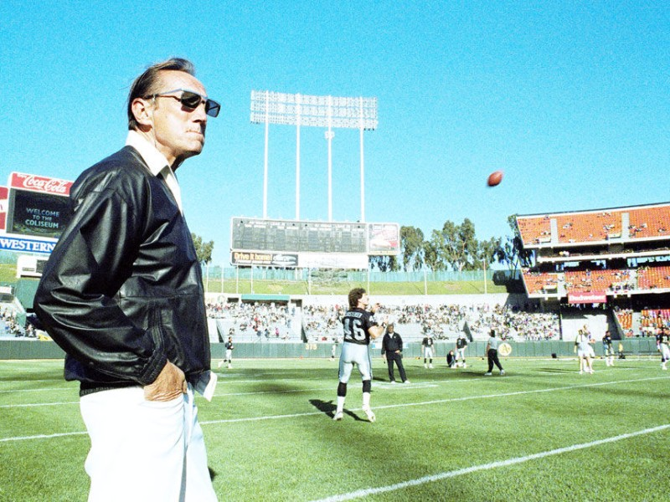
ANSWER # 5
AL DAVIS

Slide 14




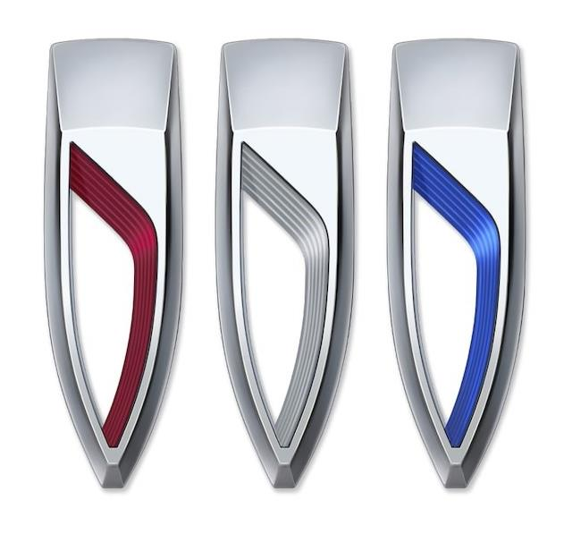
QUESTION # 6
NAME THE CAR BRANDS

Slide 15

ANSWER # 6
VOLVO

Slide 16

FERRARI

Slide 17

MASERATI

Slide 18
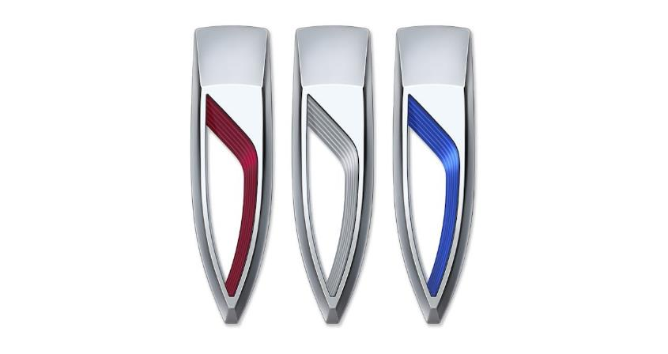
BUICK

Slide 19

NISSAN

Slide 20
QUESTION # 7 SPORTS
EACH FEBRUARY, WHICH U.S. CITY HOSTS THE BEANPOT, A HOCKEY TOURNAMENT AMONG FOUR OF THE CITY’S MAJOR COLLEGE TEAMS?

Slide 21
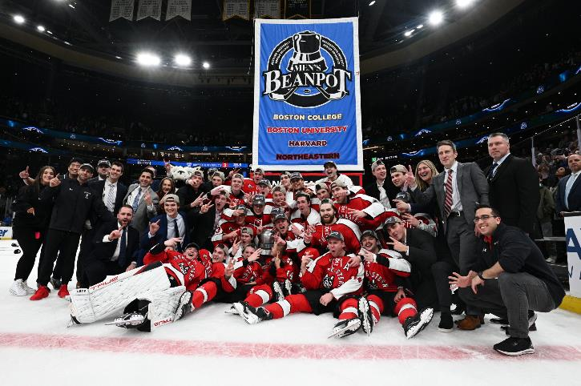
ANSWER # 7
BOSTON

Slide 22
QUESTION # 8 THE WORLD 3 - PART
OF THE TWELVE COUNTRIES IN EUROPE THAT HAVE A MONARCHY, WHICH THREE ARE LISTED FIRST ALPHABETICALLY?

Slide 23
ANSWER # 8
• ANDORRA
• BELGIUM
• DENMARK

Slide 24
QUESTION # 9 BOOKS AND LIT
WHICH NOVEL FOLLOWS THE JOAD FAMILY AS THEY FLEE THE DUST BOWL AND HEAD WEST DURING THE GREAT DEPRESSION?

Slide 25
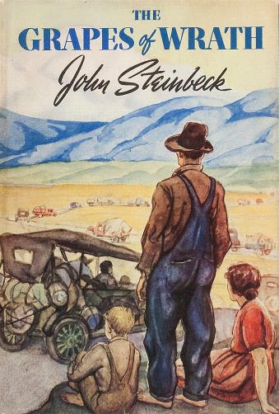
ANSWER # 9
THE GRAPES OF WRATH

Slide 26
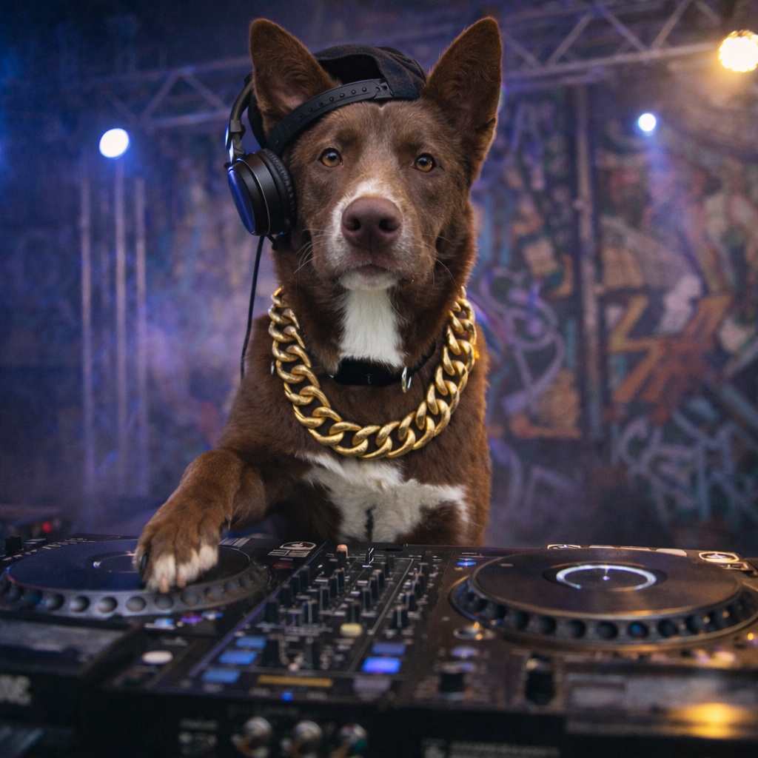

QUESTION # 10 MUSIC
3 - PART
NAME THE FOLLOWING THREE HIP-HOP SONGS FROM THE 1980’s:

Slide 27

ANSWER # 10
SONG # 1
“CHILDREN’S STORY”
(SLICK RICK)
SONG # 2
“PARENTS JUST DON’T UNDERSTAND”
(DJ JAZZY JEFF & THE FRESH PRINCE)
SONG # 3
“ME, MYSELF, AND I”
(DE LA SOUL)

Slide 28
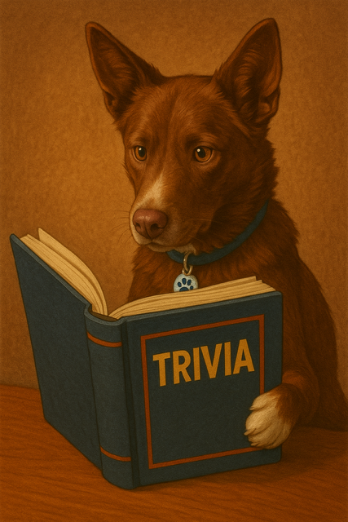
halftime
halftime

Slide 29
QUESTION # 11 MILITARY HISTORY
EMBODYING THE NAVY’S CORE VALUES, “DON’T GIVE UP THE SHIP” WAS THE DYING COMMAND OF CAPTAIN JAMES LAWRENCE DURING WHICH WAR?

Slide 30
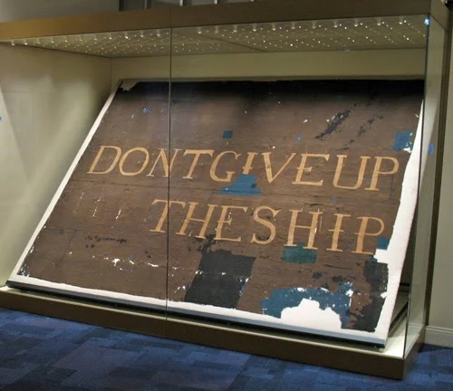
ANSWER # 11
WAR OF 1812

Slide 31
QUESTION # 12 GEOGRAPHY 2 - PART
WHAT ARE THE TWO LONGEST RIVERS THAT ARE COMPLETELY IN THE U.S., ARE EAST OF THE MISSISSIPPI RIVER, AND DO NOT HAVE THE FULL NAME OF A U.S. STATE IN THEIR NAME?

Slide 32
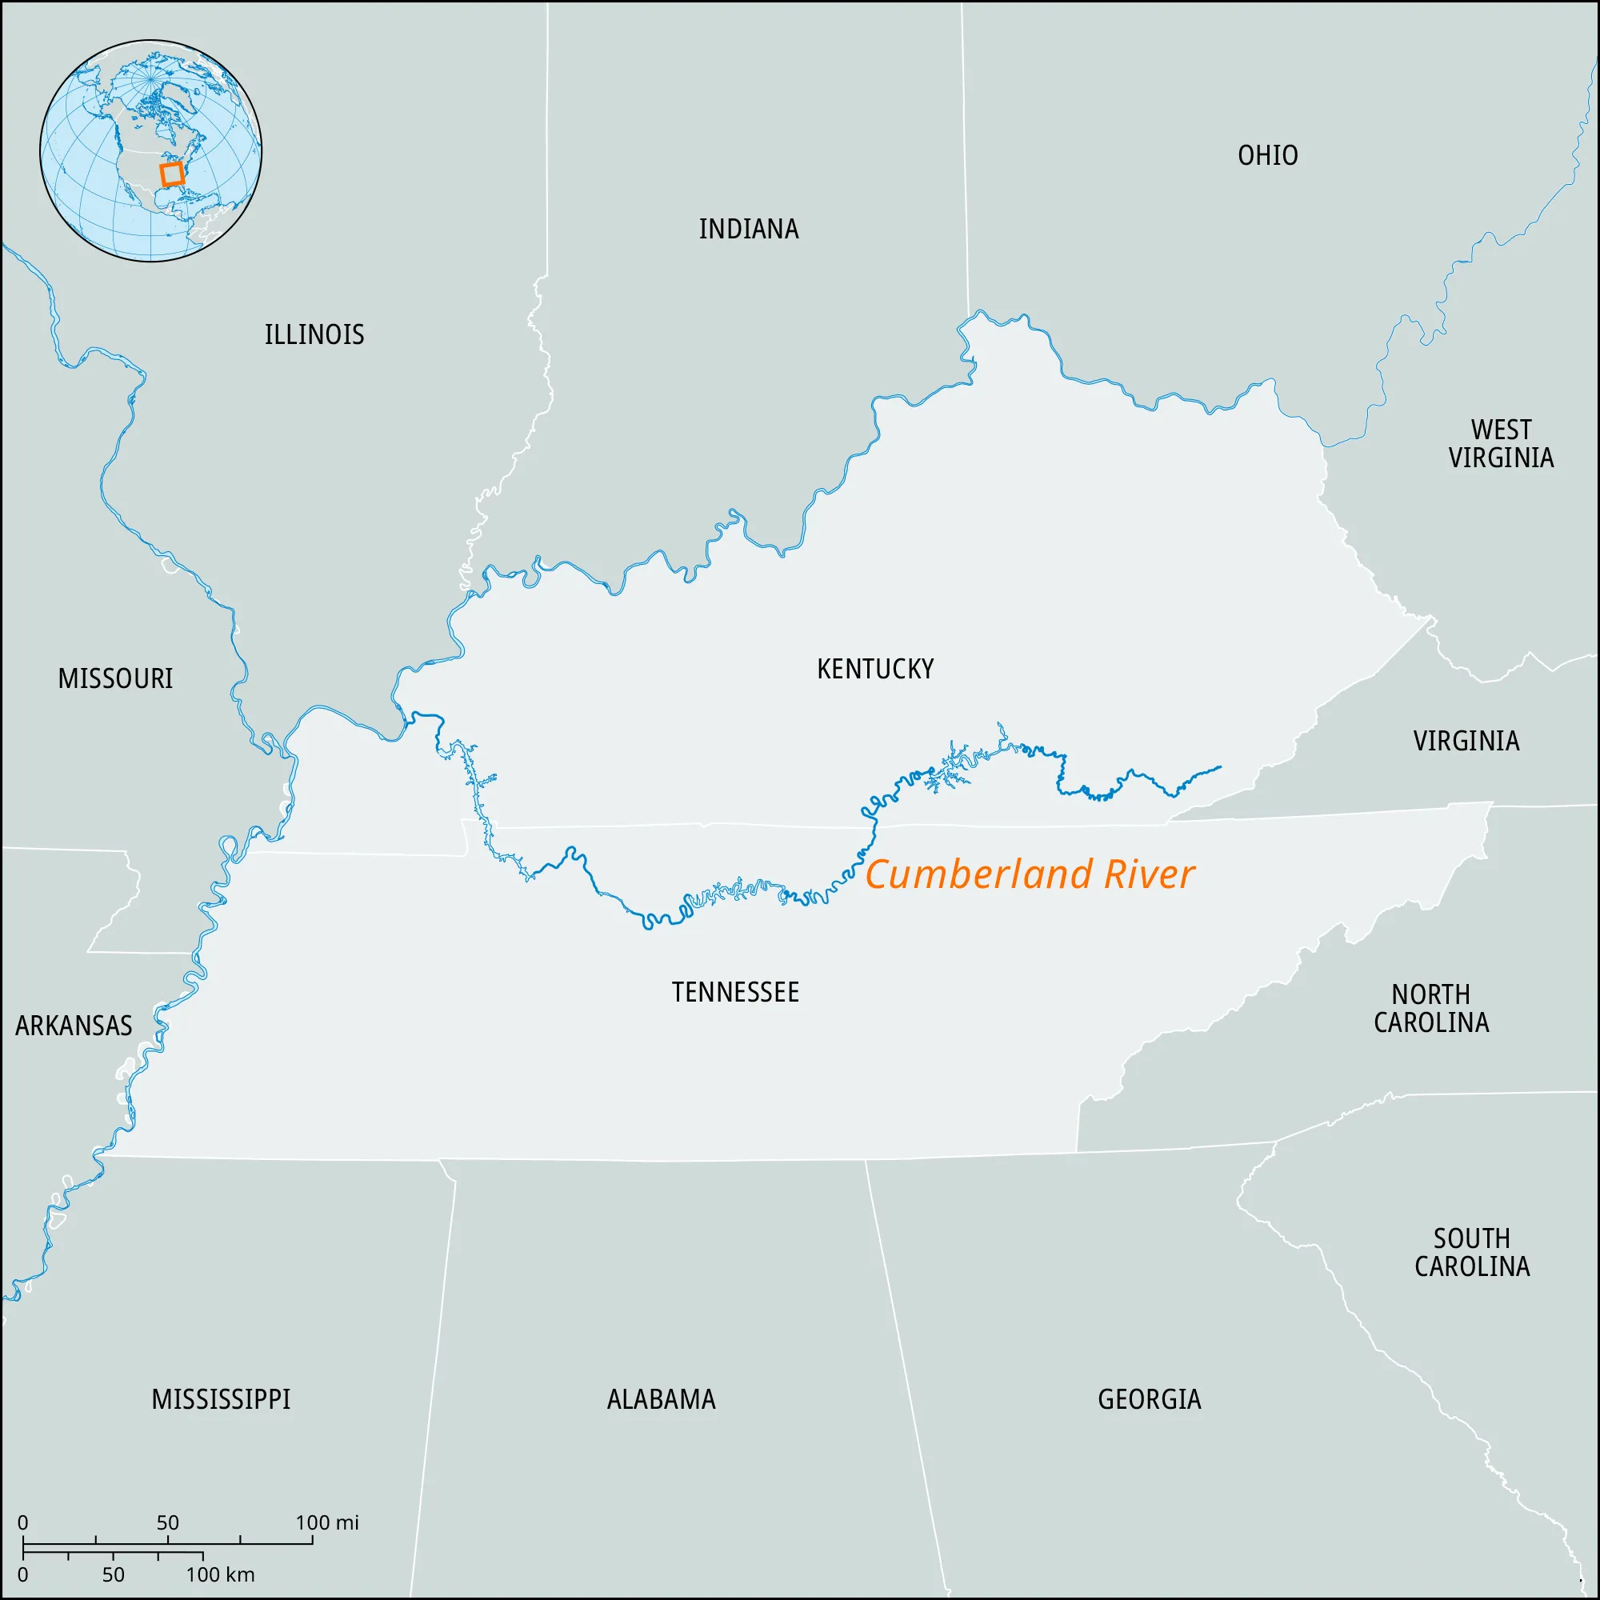
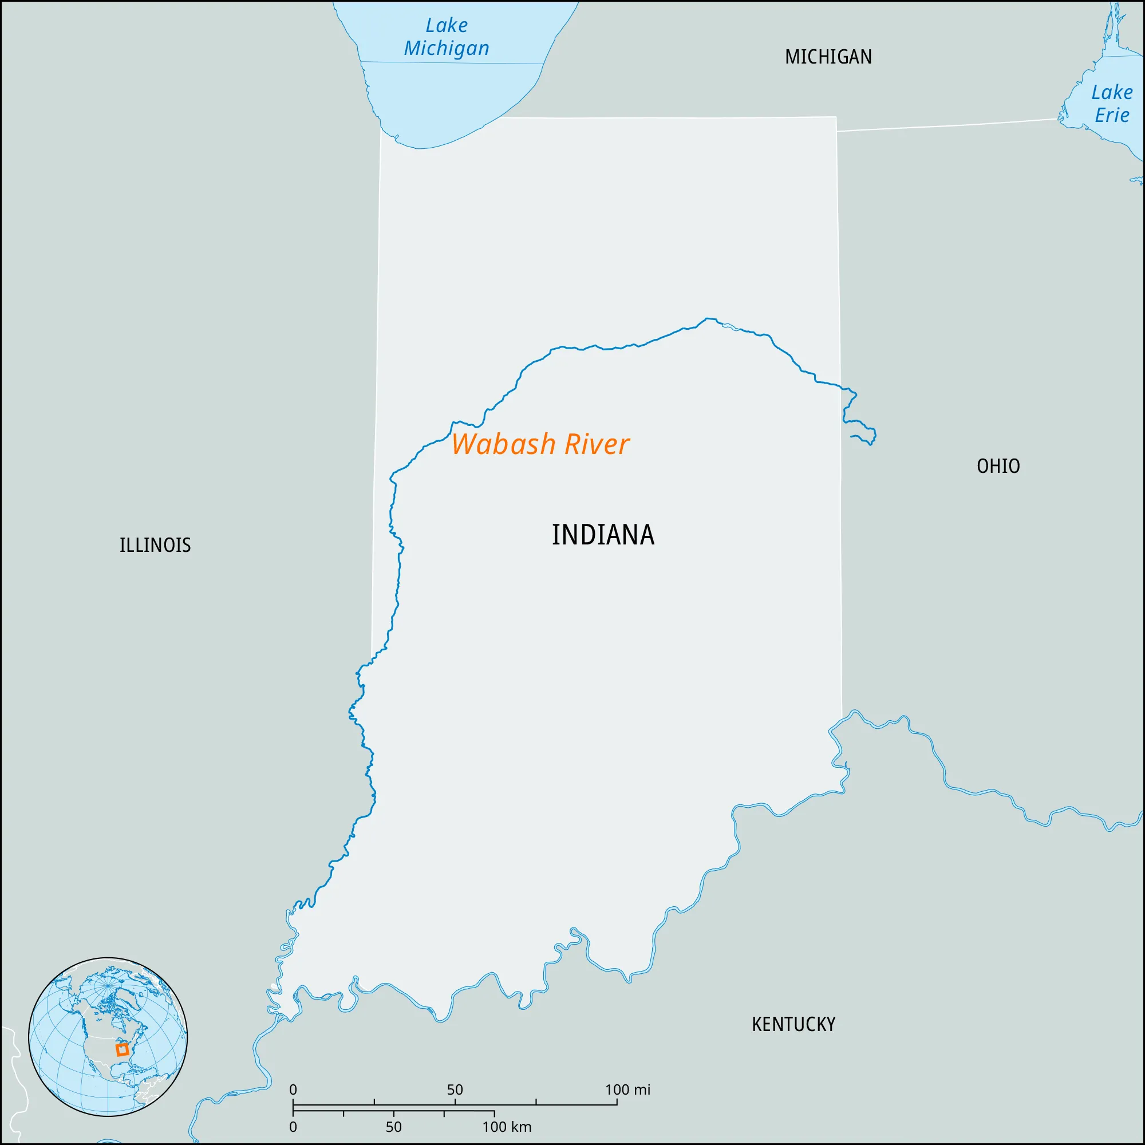
ANSWER # 12
• CUMBERLAND RIVER
• WABASH RIVER

Slide 33
QUESTION # 13 BUSINESS
WHICH U.S. STATE IS, AS OF 2024, HOME TO THE MOST HEADQUARTERS OF FORTUNE 500 COMPANIES WITH 57, INCLUDING THOSE OF CHEVRON AND WELLS FARGO?

Slide 34
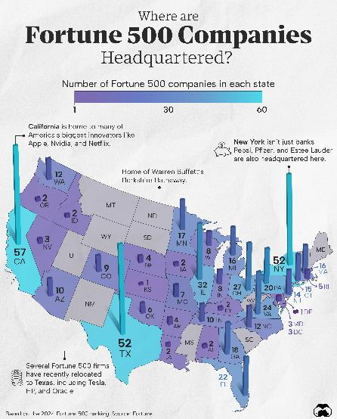
ANSWER # 13
CALIFORNIA

Slide 35
QUESTION # 14
THE WINTER OLYMPICS 3 - PART
OF THE SIX SPORTS THAT HAVE BEEN CONTESTED IN EVERY SINGLE WINTER OLYMPICS SINCE 1924, WHICH THREE DO NOT INVOLVE THE USE OF ICE SKATES?

Slide 36
ANSWER # 14
• CROSS-COUNTRY SKIING
• NORDIC COMBINED
• SKI JUMPING

Slide 37
QUESTION # 15 POLITICS
SINCE 1850, WHO IS THE ONLY DEMOCRATIC PRESIDENT THAT RAN IN TWO ELECTIONS AND NEVER WON CALIFORNIA?

Slide 38
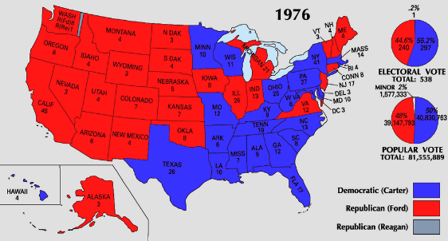
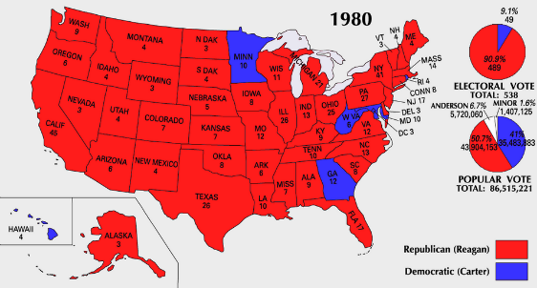
ANSWER # 15
JIMMY CARTER

Slide 39
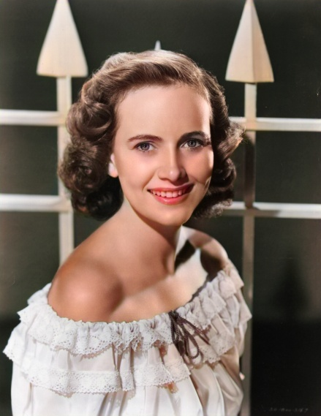
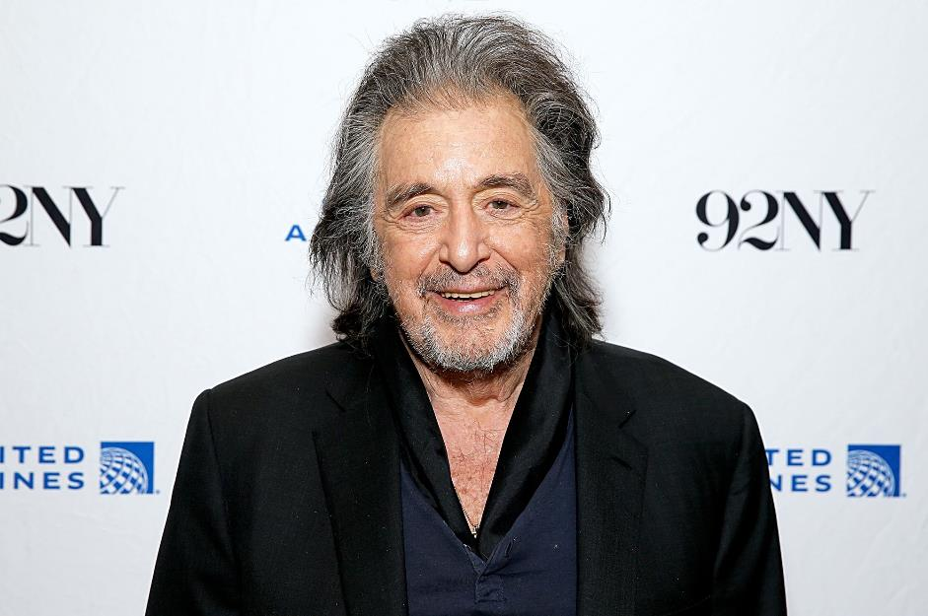
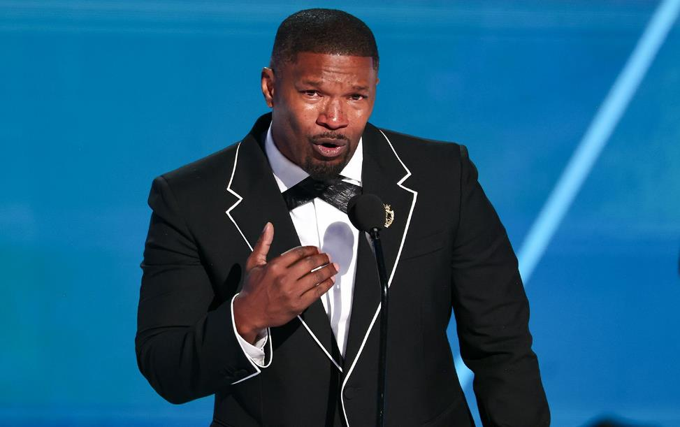
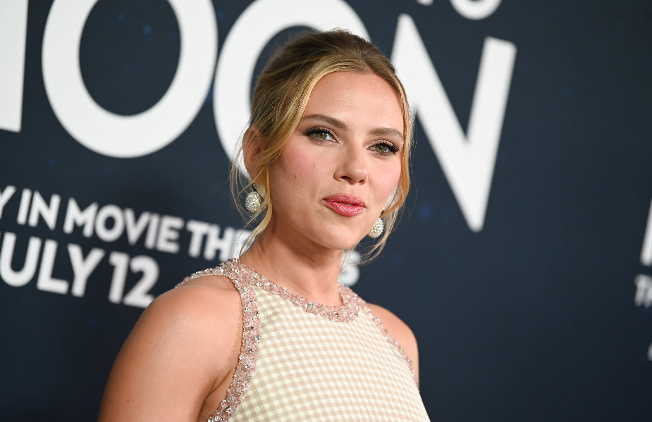
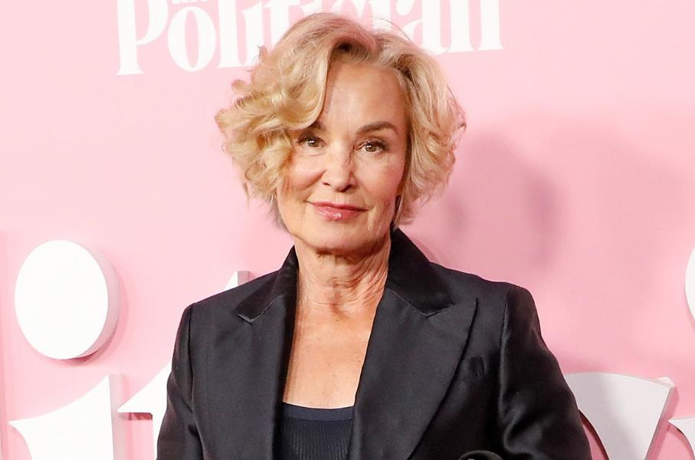
QUESTION # 16
WHO ARE WE AND WHAT IS THE SPECIFIC CONNECTION?

Slide 40
ANSWER # 16
THE CONNECTION IS…
THEY HAVE ALL BEEN NOMINATED FOR MULTIPLE ACTING ACADEMY AWARDS IN THE SAME YEAR

Slide 41

SCARLETT JOHANSSON - 2019
(MARRIAGE STORY AND JOJO RABBIT)

Slide 42

JESSICA LANGE - 1982
(FRANCES AND TOOTSIE)

Slide 43
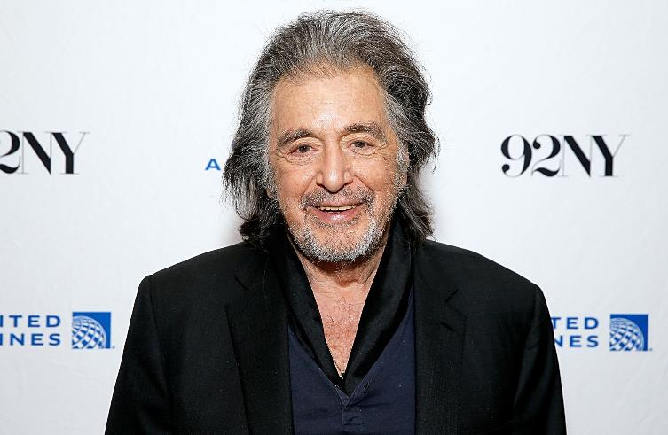
AL PACINO - 1992
(SCENT OF A WOMAN AND GLENGARRY GLEN ROSS)

Slide 44
TERESA WRIGHT - 1942
(THE PRIDE OF THE YANKEES AND MRS. MINIVER)

Slide 45

JAMIE FOXX - 2004
(RAY AND COLLATERAL)

Slide 46
QUESTION # 17 NICKNAMES
BORN IN 1930, THE AUTHOR OF THE THESIS LINE-OF-SIGHT GUIDANCE TECHNIQUES FOR MANNED ORBITAL RENDEZVOUS SHARES WHAT NICKNAME WITH THE AUTHOR OF THE 1990 BOOK FRIDAY NIGHT LIGHTS: A TOWN, A TEAM, AND A DREAM?

Slide 47
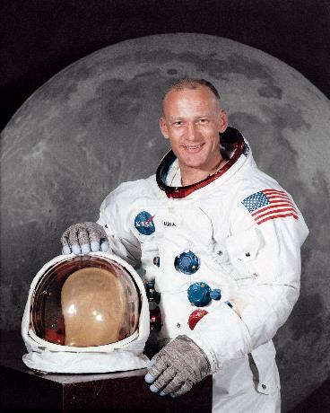
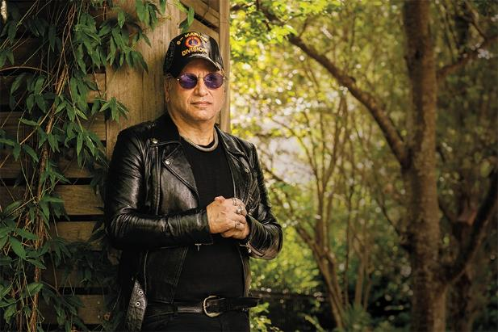
ANSWER # 17
“BUZZ”

Slide 48
QUESTION # 18 7 – 3 – 1
⑦ RUNNING FOR 98 EPISODES AND A SPIN OFF NOVEL, A MAIN CHARACTER IN THIS SHOW HAD THE LAST NAME OF “GRANT”
③ THE PILOT EPISODE WAS FILMED IN HAWAII THE SAME DAY THAT JFK WAS ASSASSINATED
① THE STORY OF SEVEN PEOPLE ON A “THREE HOUR TOUR” ON THE SS MINNOW

Slide 49
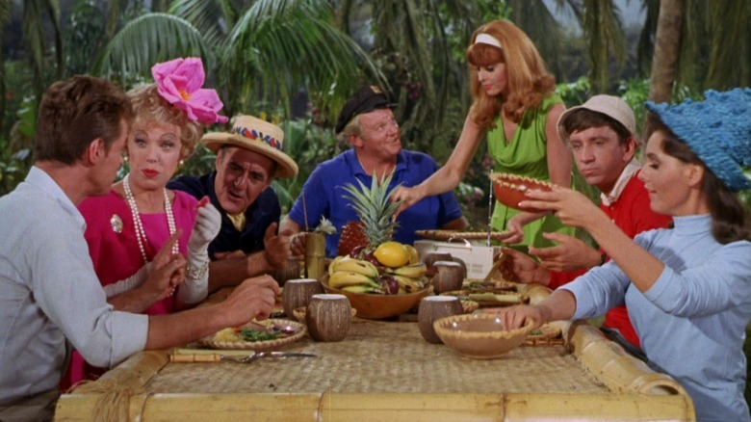
ANSWER # 18
GILLIGAN’S ISLAND

Slide 50
QUESTION # 19 THE COMICS
CREATED BY GEORGE GATELY IN 1973, WHICH FELINE COMIC STRIP HAS BEEN AUTHORED BY GATELY’S NEPHEW SINCE 1988?

Slide 51
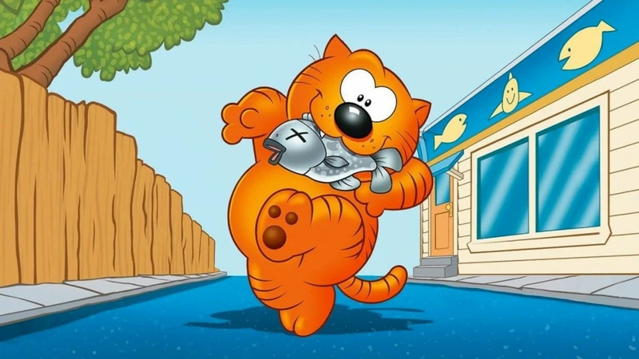
ANSWER # 19
HEATHCLIFF

Slide 52
QUESTION # 20 WAGER UP TO 15 POINTS
U.S. HISTORY
INTERVIEWED ON 60 MINUTES, INSTRUMENTAL IN THE CREATION OF A COMPUTER LANGUAGE, WHICH U.S. NAVY REAR ADMIRAL FINALLY RETIRED FROM ACTIVE DUTY IN 1986, JUST A FEW MONTHS SHY OF THEIR 80TH BIRTHDAY?

Slide 53
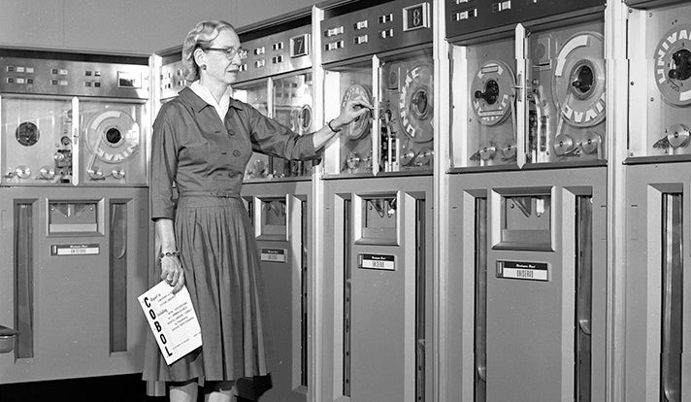

ANSWER # 20
GRACE HOPPER

Slide 54
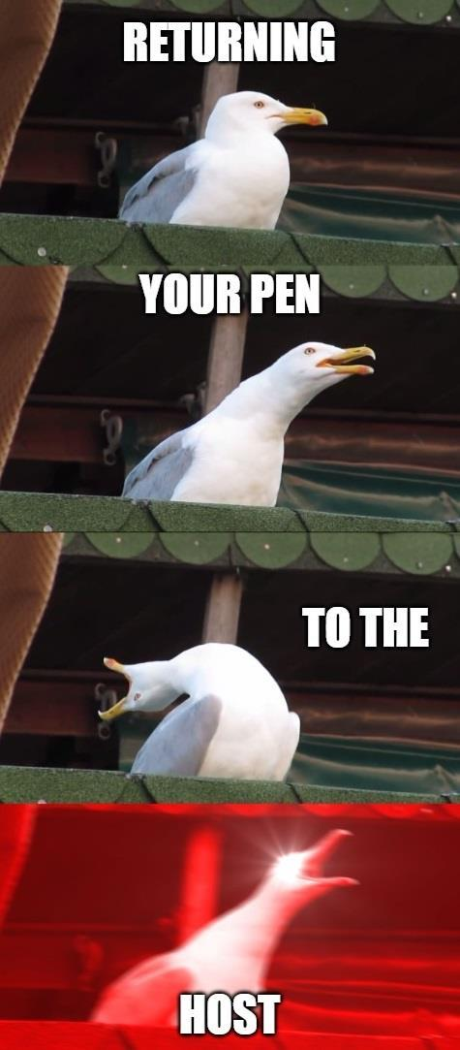
triviamaryland
triviamaryland

Slide 55
TIE BREAKER ANSWER
518 words

