Slide 1
QUESTION # 1
AMERICAN HISTORY
ON JUNE 25, 1876, WHICH LIEUTENANT COLONEL OF THE U.S. ARMY WAS KILLED DURING THE BATTLE OF LITTLE BIGHORN?

Slide 2
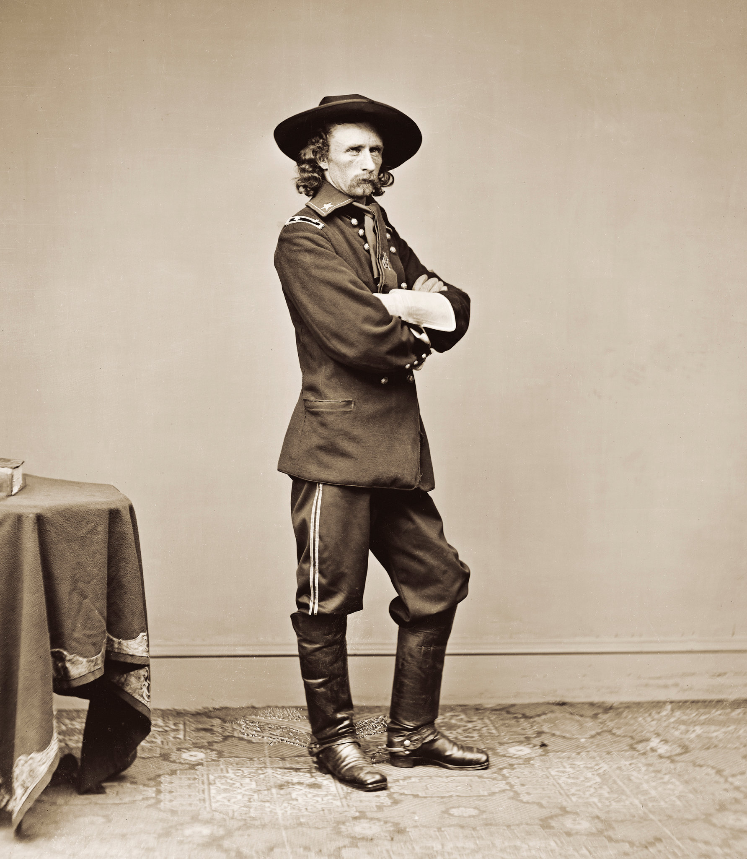
ANSWER # 1
GEORGE ARMSTRONG CUSTER

Slide 3
QUESTION # 2
TELEVISION
3 - PART
NOT INCLUDING GAME SHOWS, WHICH THREE T.V. SHOWS HAS MICHAEL J. FOX APPEARED IN AT LEAST 26 EPISODES?

Slide 4
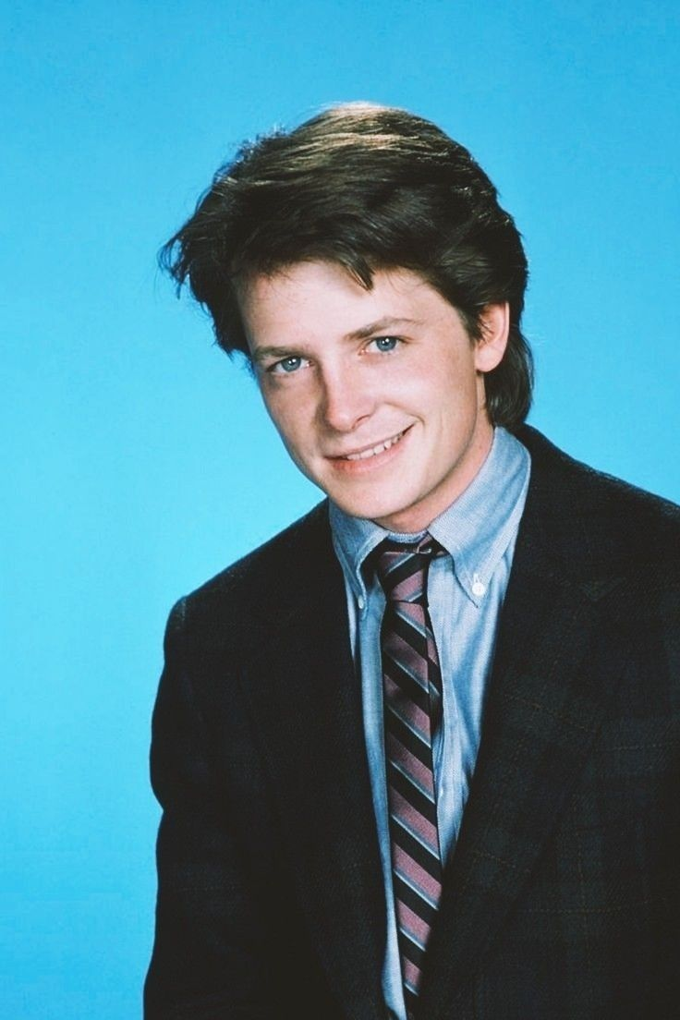
ANSWER # 2
· FAMILY TIES
· SPIN CITY
· THE GOOD WIFE

Slide 5
TIE BREAKER QUESTION
LOCATED ON THE BORDER BETWEEN ZAMBIA AND ZIMBABWE, IN FEET, WHAT IS THE MAXIMUM DEPTH OF LAKE KARIBA?

Slide 6
QUESTION # 3
THE BODY HUMAN
OFTEN FOUND DURING A PITCHING DUEL, WHAT ELECTROLYTE IS THE MOST ABUNDANT CATION FOUND IN INTRACELLULAR FLUID?

Slide 7
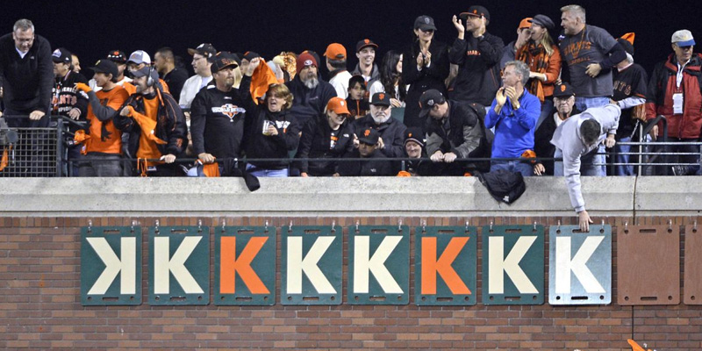
ANSWER # 3
POTASSIUM (K)

Slide 8
QUESTION # 4
THE WOMEN’S NATIONAL BASKETBALL ASSOCIATION
4 - PART
PRIOR TO THIS SEASON, WHICH FOUR LADIES HAVE BEEN NAMED ROOKIE OF THE YEAR FOR THE WNBA SINCE 2022?

Slide 9
ANSWER # 4
• RHYNE HOWARD
• ALIYAH BOSTON
• CAITLIN CLARK
• PAIGE BUECKERS

Slide 10
QUESTION # 5
SCIENCE
THE BYPRODUCT LEFTOVER AFTER SEPARATING METAL FROM RAW ORE, WHICH FOUR-LETTER WORD IS SOMETIMES USED FOR SOIL STABILIZATION AND RAILROAD CONSTRUCTION?

Slide 11
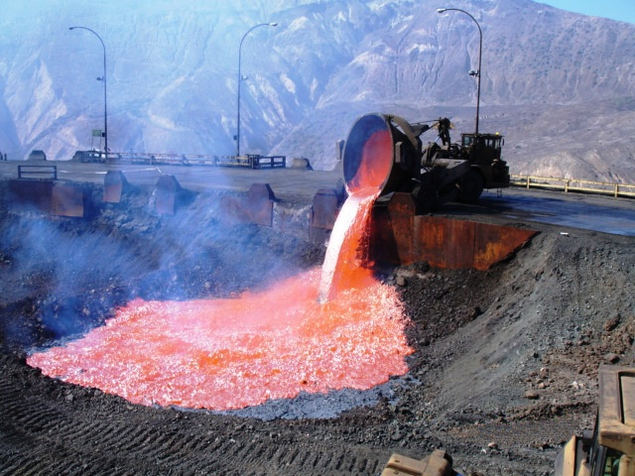
ANSWER # 5
SLAG

Slide 12





QUESTION # 6
NAME THE U.S. STATE CAPITAL

Slide 13
ANSWER # 6
ANNAPOLIS

Slide 14

TALLAHASSEE

Slide 15

SACRAMENTO

Slide 16

BATON ROUGE

Slide 17
ALBANY

Slide 18
QUESTION # 7
BOOKS AND LIT
“THE SUN DID NOT SHINE, IT WAS TOO WET TO PLAY, SO WE SAT IN THE HOUSE ALL THAT COLD, COLD WET DAY” IS THE OPENING LINE TO WHICH SEMINAL BOOK?

Slide 19

ANSWER # 7
THE CAT IN THE HAT

Slide 20
QUESTION # 8
MUSIC
3 - PART
WHICH THREE SOLO SONGS BY HARRY STYLES PEAKED AT # 1 ON THE BILLBOARD HOT 100 CHARTS?

Slide 21
ANSWER # 8
• “AS IT WAS”
• “WATERMELON SUGAR”
• “APERTURE”

Slide 22
QUESTION # 9
FASHION
FOUNDED DURING 1975 IN CONNECTICUT, WHAT ANIMAL IS FEATURED ON THE LOGO FOR DOONEY & BOURKE?

Slide 23
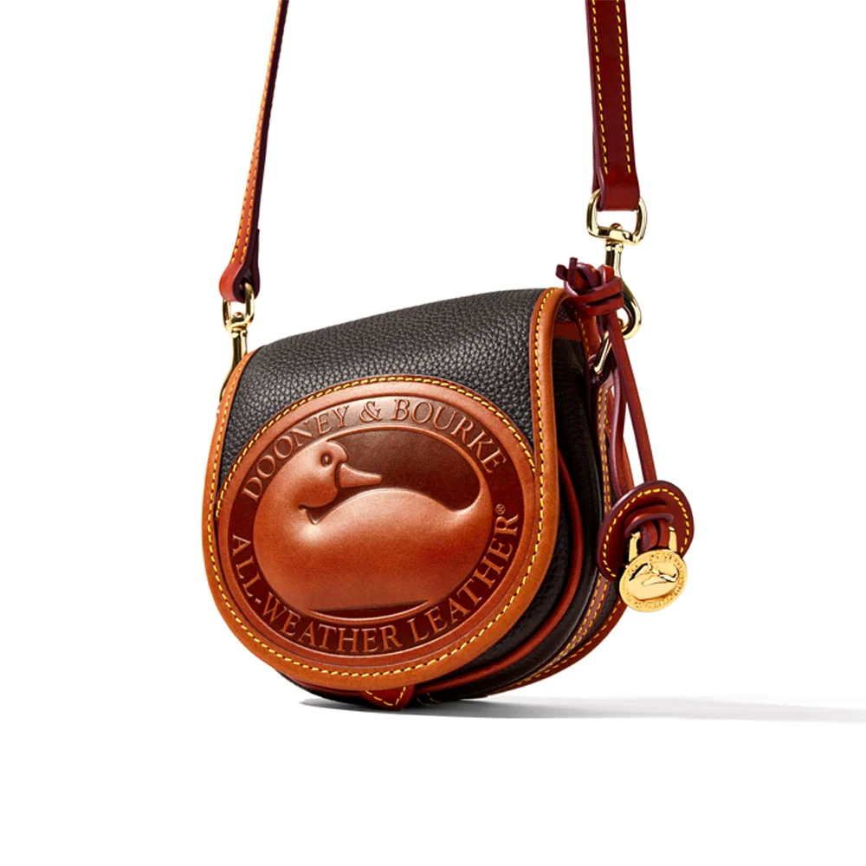
ANSWER # 9
DUCK

Slide 24


QUESTION # 10 MUSIC
3 - PART
NAME THE FOLLOWING THREE HITS FROM THE 1950’s:

Slide 25
ANSWER # 10
SONG # 1
“THE GREAT PRETENDER”
(THE PLATTERS)
SONG # 2
“ALL I HAVE TO DO IS DREAM”
(THE EVERLY BROTHERS)
SONG # 3
“JOHNNY B. GOODE”
(CHUCK BERRY)

Slide 26

halftime
halftime

Slide 27
QUESTION # 11
CURRENCY
FEATURING CHARLES III ON THE OBVERSE, WHICH MAMMAL IS FEATURED ON THE REVERSE SIDE OF THE STANDARD CANADIAN TWO DOLLAR COIN?

Slide 28
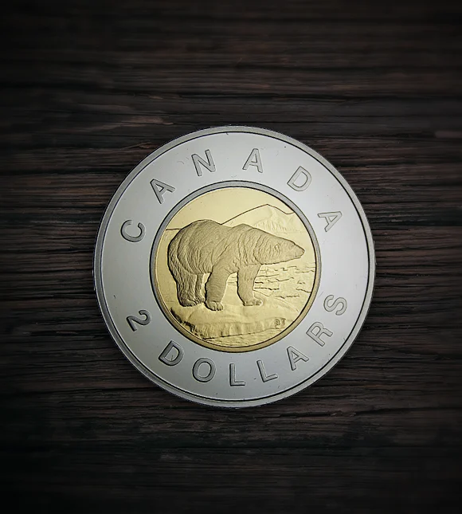
ANSWER # 11
POLAR BEAR

Slide 29
QUESTION # 12
FUN AND GAMES
5 - PART
OF THE 10 CLASSIC SCRABBLE TILES THAT ARE WORTH 1 POINT EACH, WHICH FIVE ARE NOT VOWELS?

Slide 30
ANSWER # 12
• L
• N
• R
• S
• T

Slide 31
QUESTION # 13
WORLD HISTORY
ALTHOUGH LARGELY OVERSHADOWED BY HIS PRIME MINISTER, VICTOR EMMANUEL III SERVED AS THE KING OF WHICH COUNTRY FROM 1900 UNTIL 1946?

Slide 32
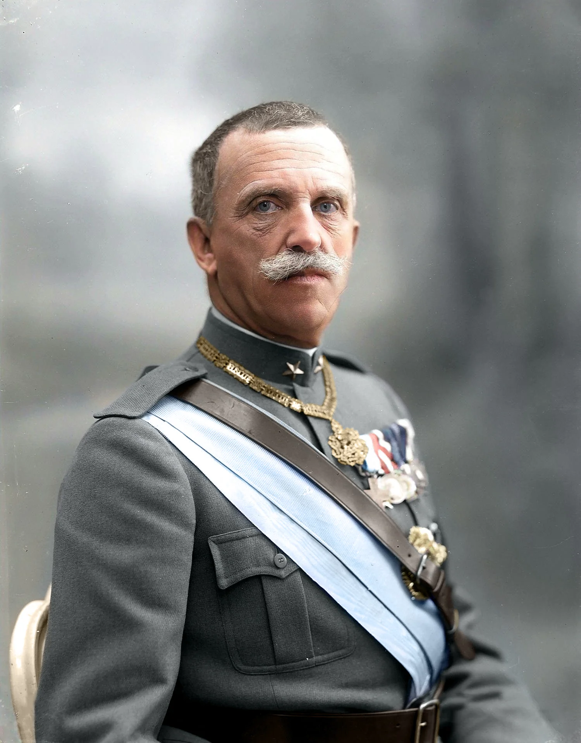
ANSWER # 13
ITALY

Slide 33
QUESTION # 14
THE NATIONAL FOOTBALL LEAGUE
4 - PART
SINCE THE 1966 NFL MERGER, WHO ARE THE ONLY FOUR PLAYERS TO HAVE WON A NCAA NATIONAL CHAMPIONSHIP AND A SUPER BOWL AS A STARTING QUARTERBACK?

Slide 34
ANSWER # 14
· JOE NAMATH
· KEN STABLER
· JOE MONTANA
· JALEN HURTS

Slide 35
QUESTION # 15
TIME
UNTIL A NEW CALENDAR WAS IMPLEMENTED IN 45 BCE, WHAT MODERN MONTH WAS KNOWN AS QUINTILIS?

Slide 36
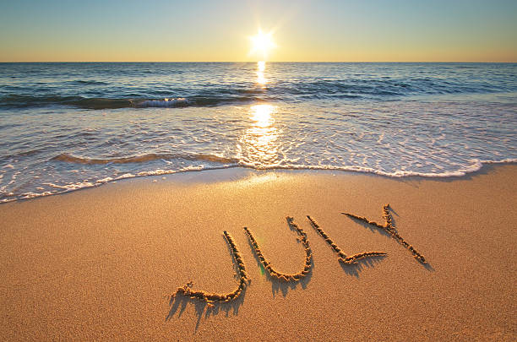
ANSWER # 15
JULY

Slide 37
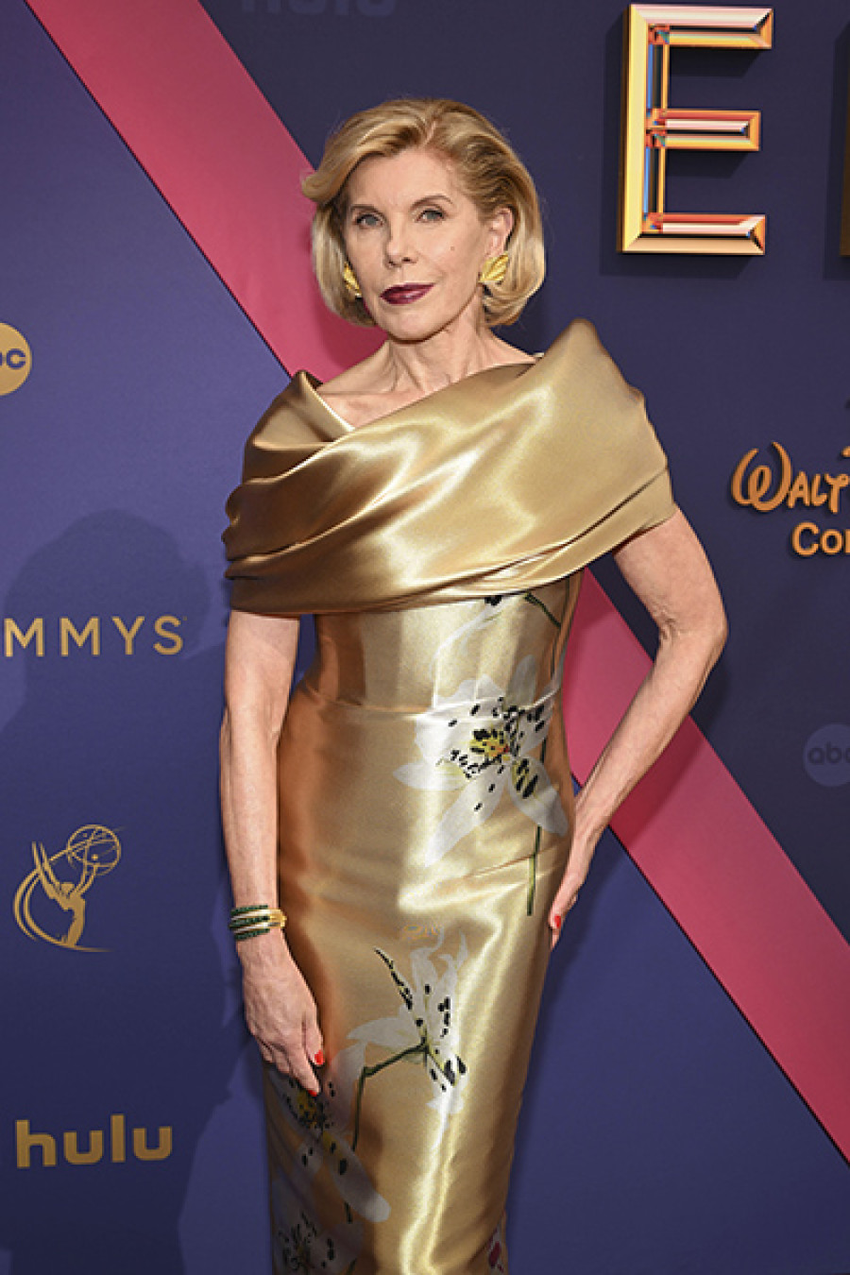
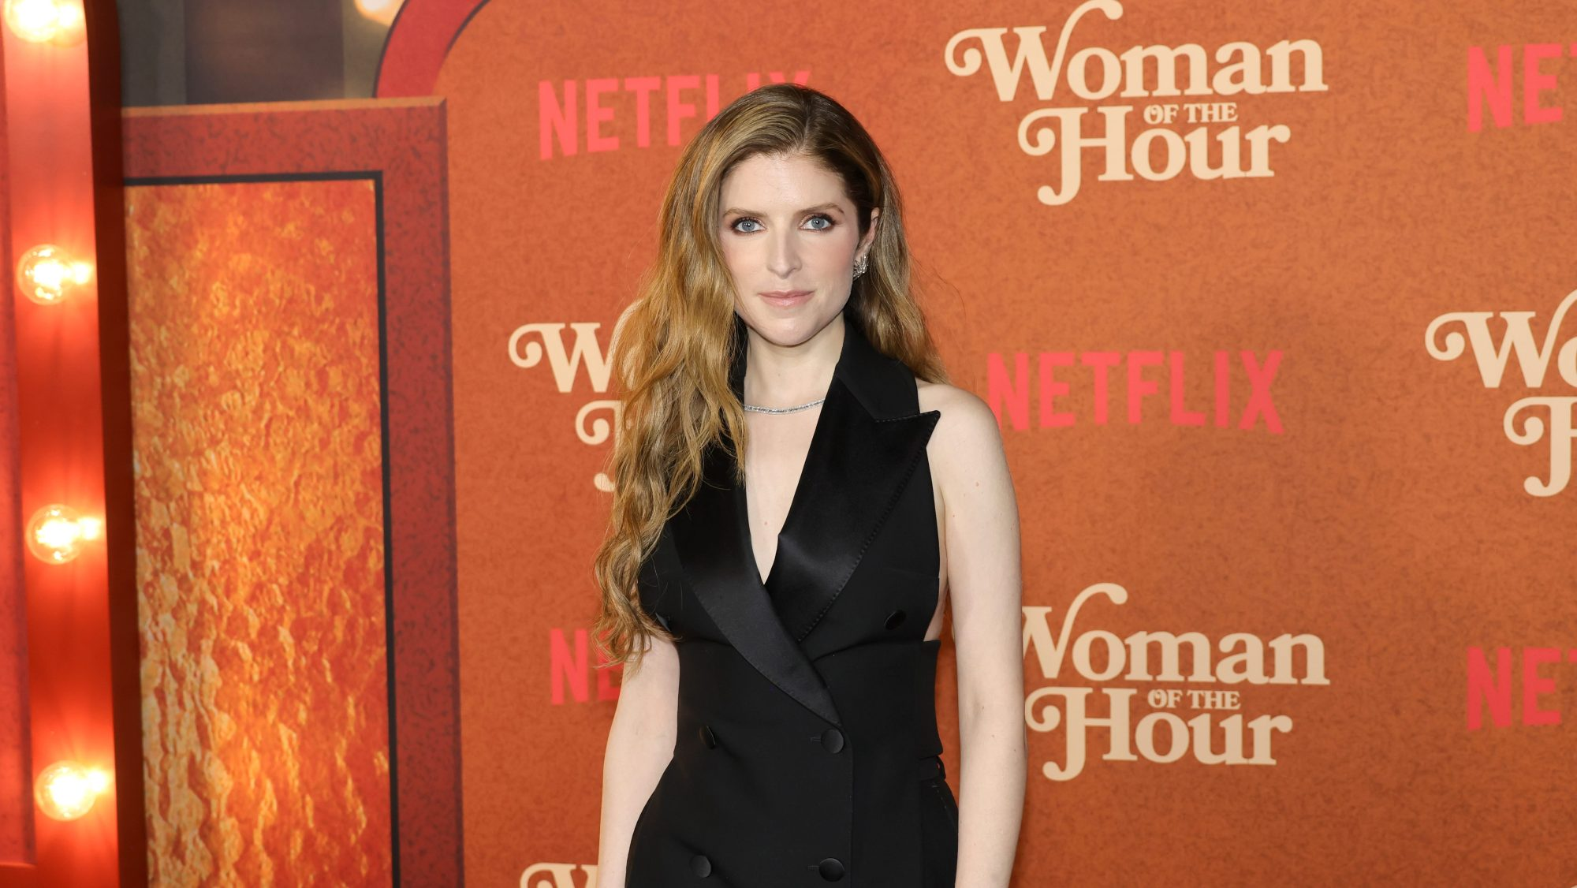
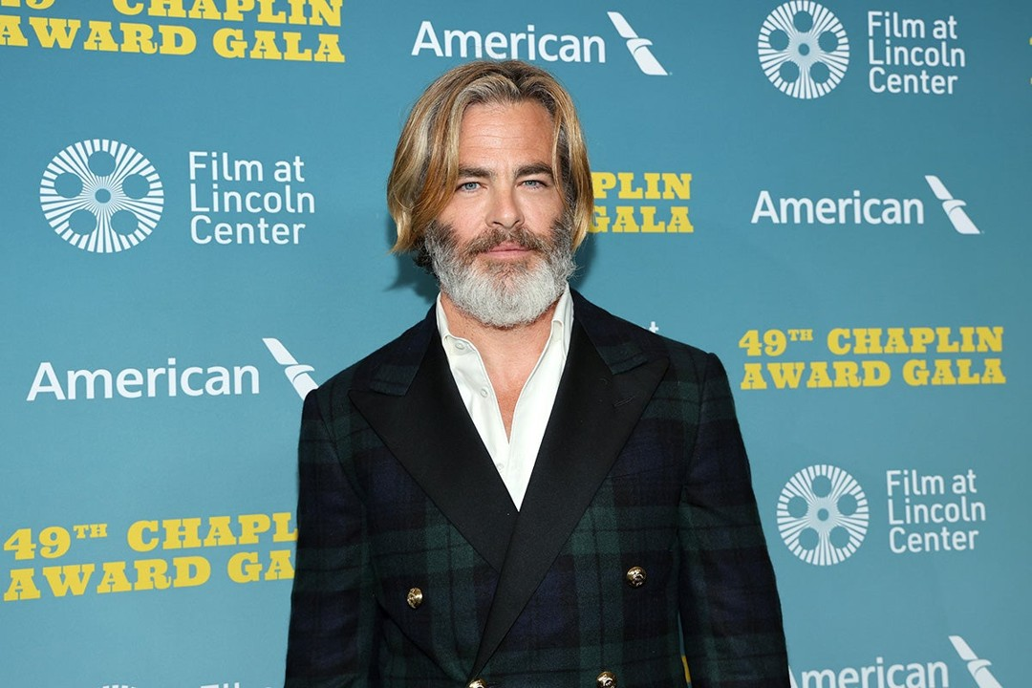
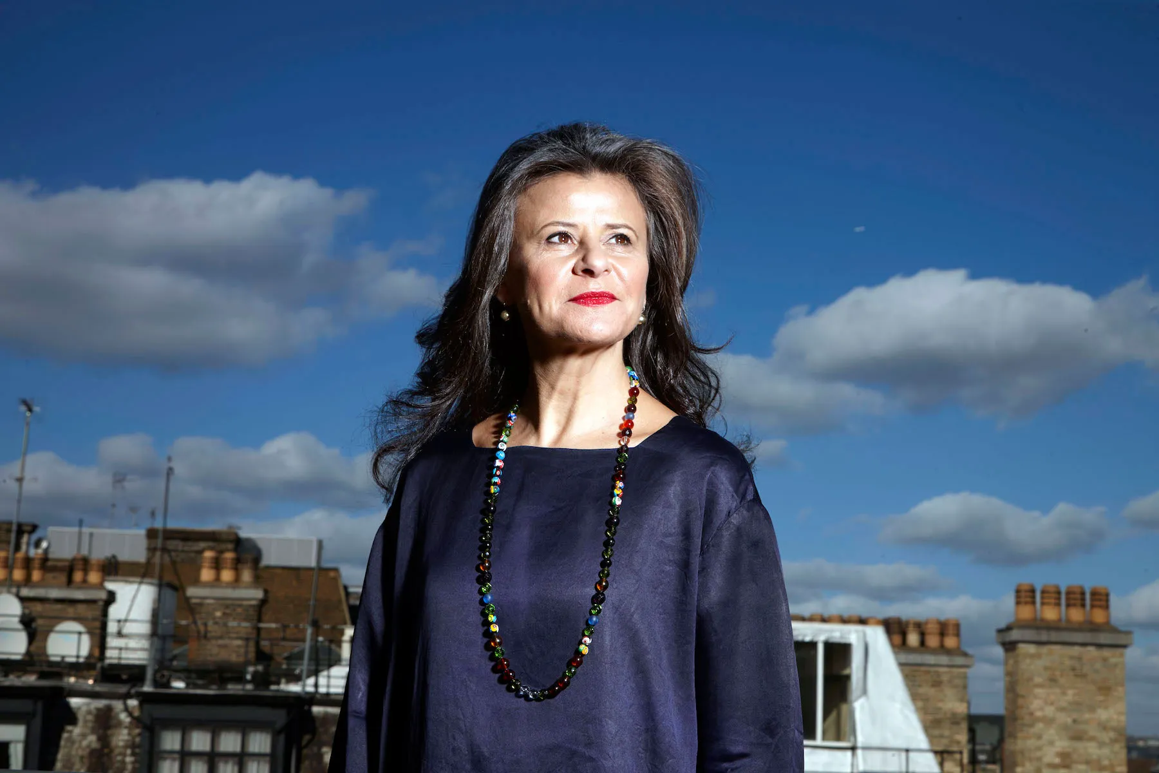

QUESTION # 16
WHO ARE WE AND WHAT FILM DID WE ALL APPEAR IN?

Slide 38
ANSWER # 16
ANNA KENDRICK

Slide 39
TRACEY ULLMAN

Slide 40
CHRIS PINE

Slide 41
CHRISTINE BARANSKI

Slide 42
EMILY BLUNT

Slide 43

ANSWER # 16
THEY ALL APPEARED IN…

Slide 44
QUESTION # 17
POTAMOLOGY
RUNNING FOR OVER 50 MILES, WHAT RIVER FLOWS THROUGH KILDARE, LEIXLIP, CARAGH, AND DUBLIN?

Slide 45
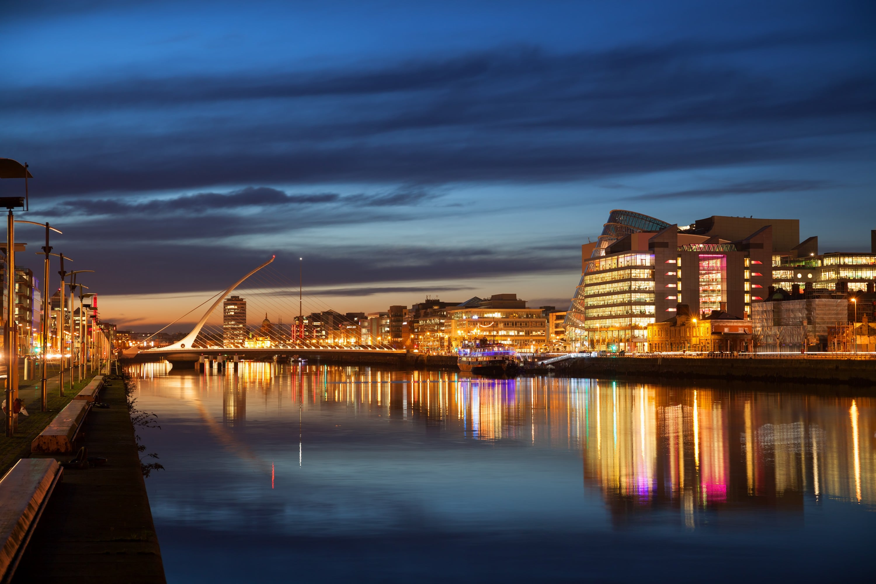
ANSWER # 17
RIVER LIFFEY

Slide 46
QUESTION # 18
THE ACADEMY AWARDS
2 - PART
SINCE 2000, WHICH TWO AWARD CATEGORIES HAVE BEEN ADDED TO THE LIST OF AWARDS PRESENTED AT THE OSCARS?

Slide 47
ANSWER # 18
· BEST ANIMATED FEATURE FILM
· BEST ACHIEVEMENT IN CASTING

Slide 48
QUESTION # 19
SNACKS AND WATERS!
ACCORDING TO THE BARTENDER’S ASSOCIATION, WHAT MIXED DRINK IS MADE FROM WHITE AND DARK RUMS, LIME JUICE, ORANGE CURAÇAO, AND ORGEAT SYRUP?

Slide 49
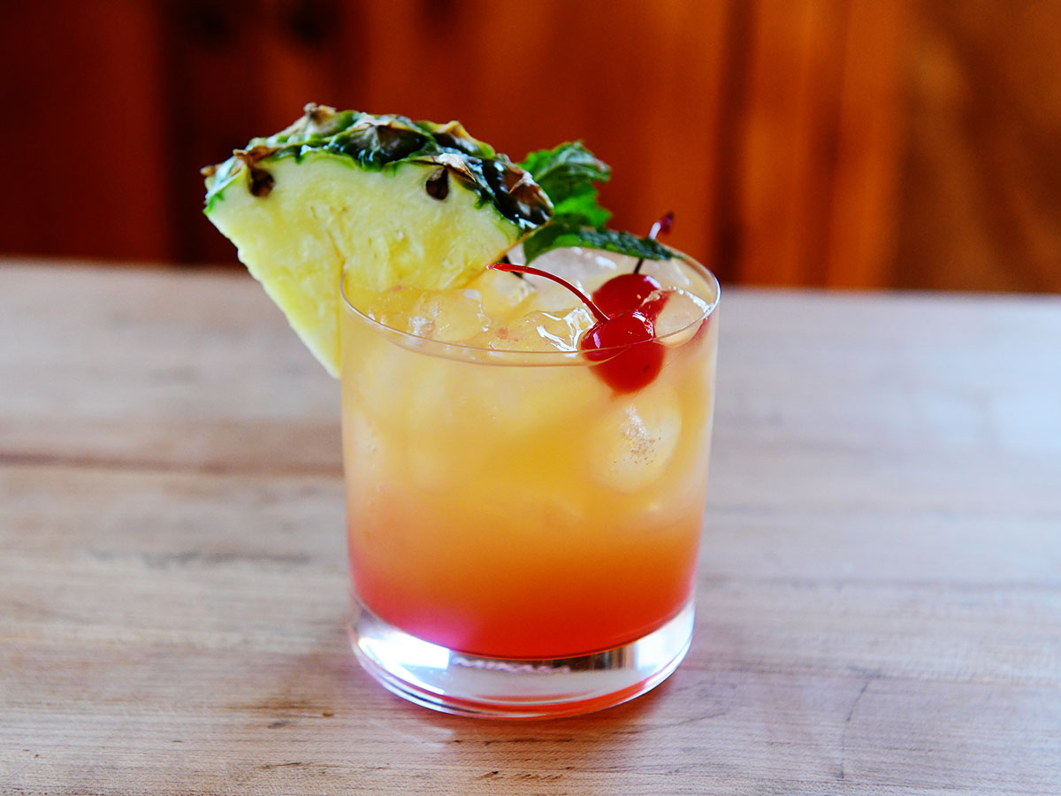
ANSWER # 19
MAI TAI

Slide 50
QUESTION # 20
LANDMARKS
WAGER UP TO 15 POINTS
LOCATED NEAR THE CENTER OF AMERICA’S MOST “EXPENSIVE” 639 ACRES OF REAL ESTATE, WHAT RICH AND JONES DESIGNED MONUMENT WAS UNVEILED IN 1921?

Slide 51
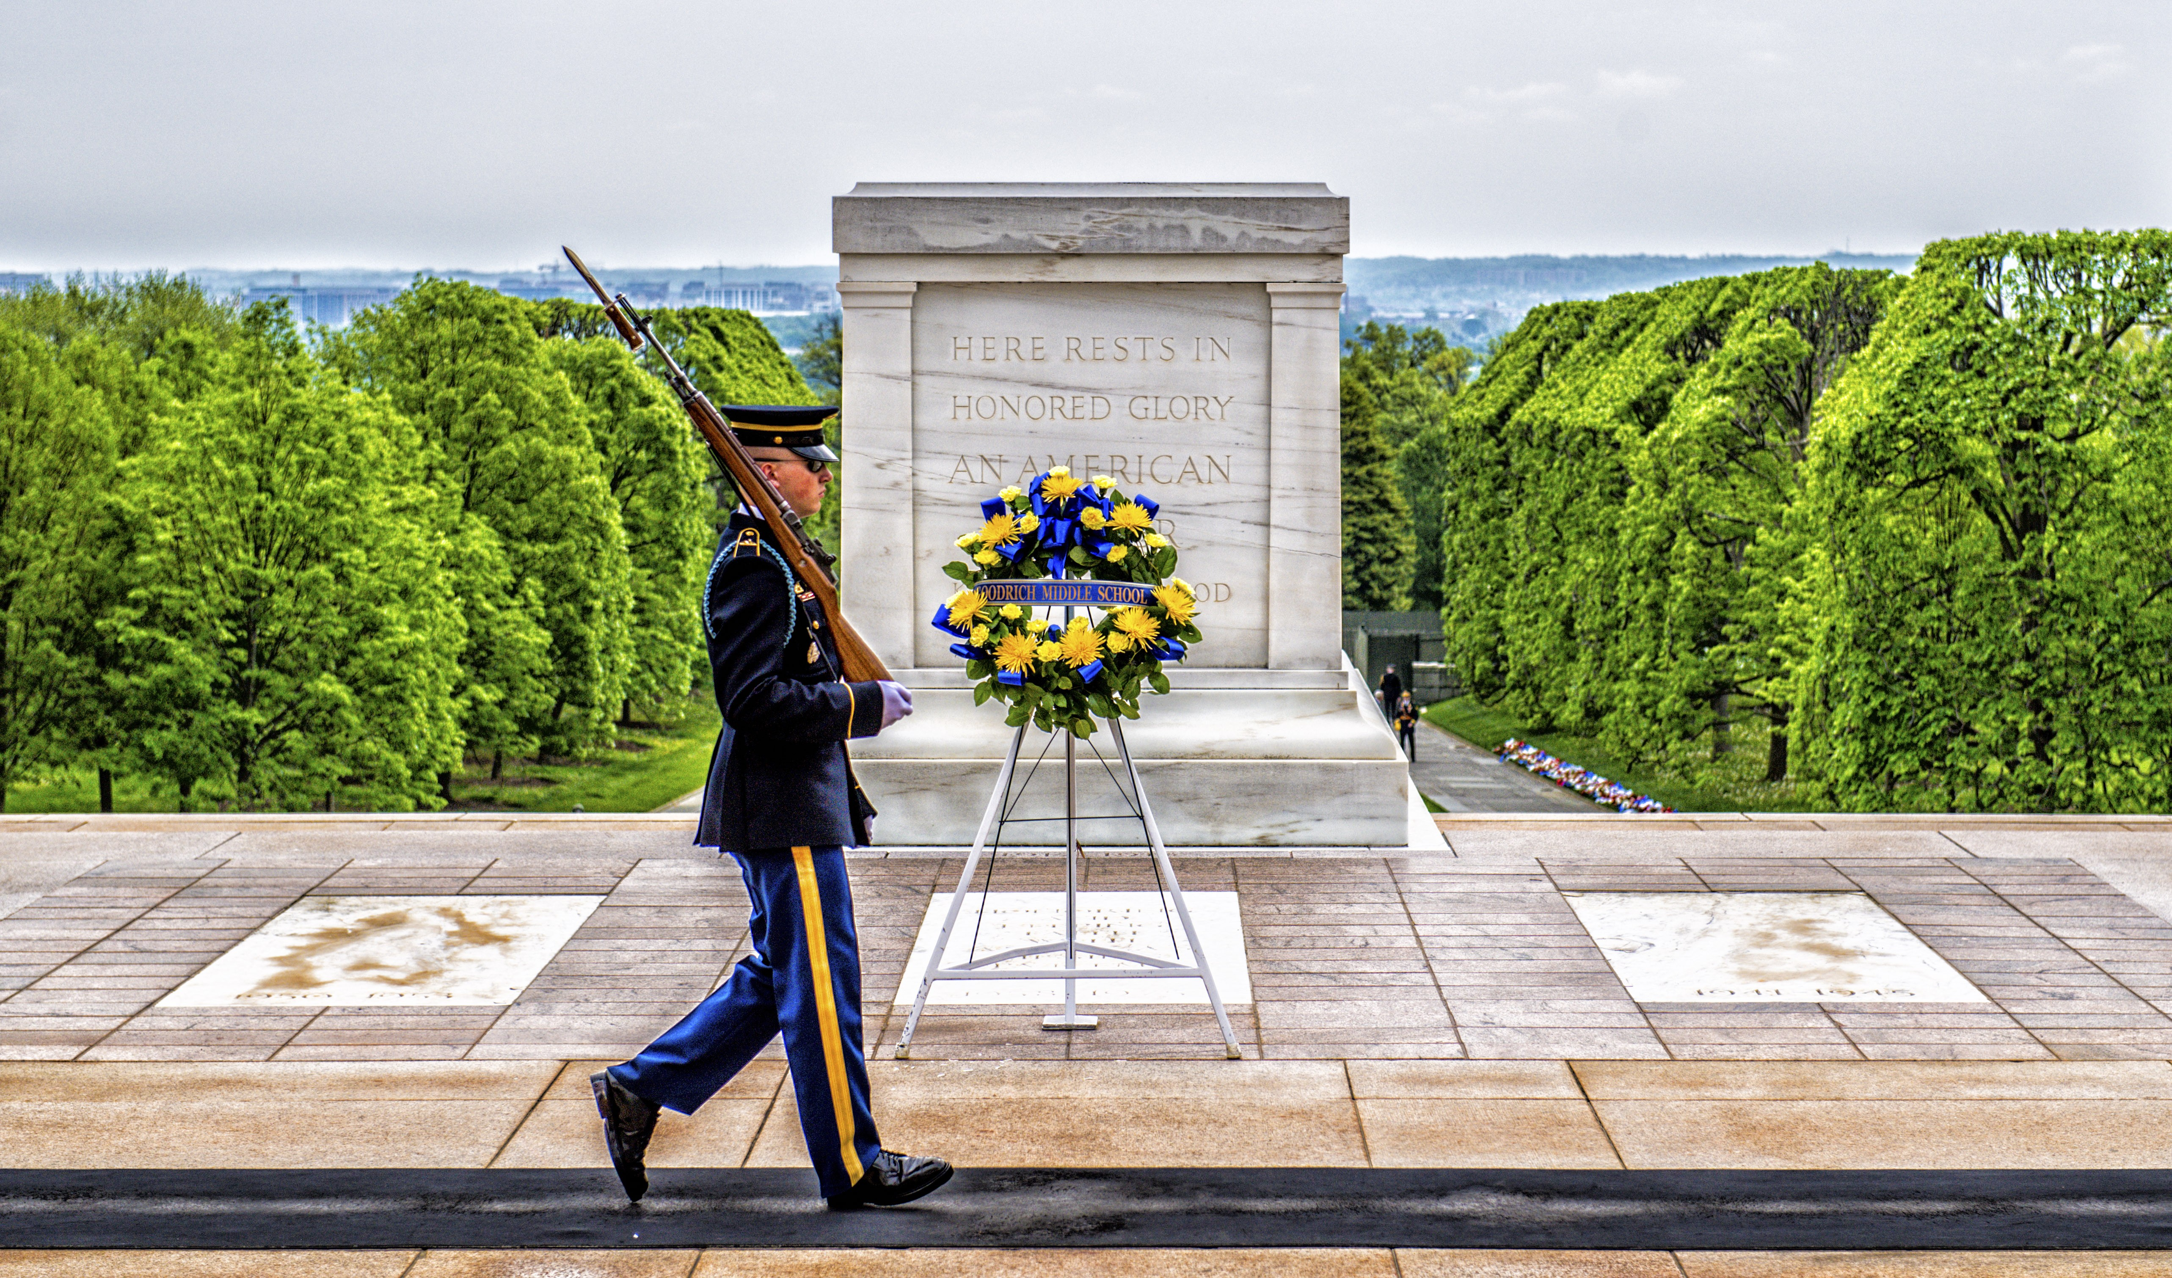
ANSWER # 20
TOMB OF THE UNKNOWN SOLDIER

Slide 52

triviamaryland
triviamaryland

Slide 53
TIE BREAKER ANSWER
318 feet

